Slide 1
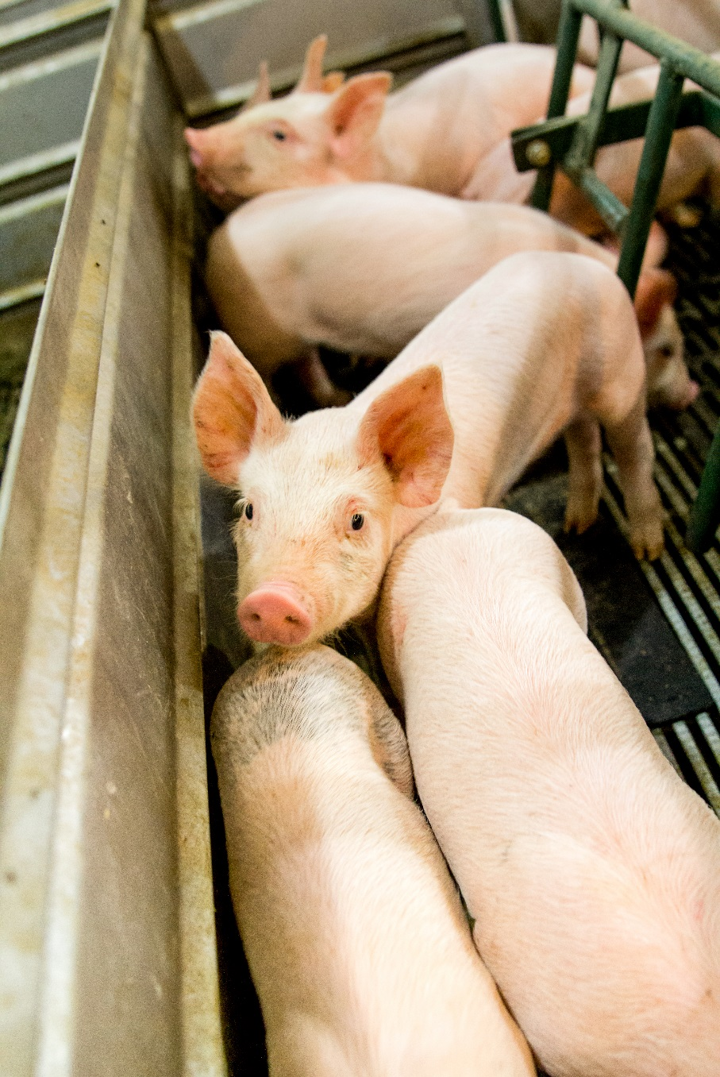
Safe Pig Handling:
Weaning Pigs
National Pork Board

Slide 2
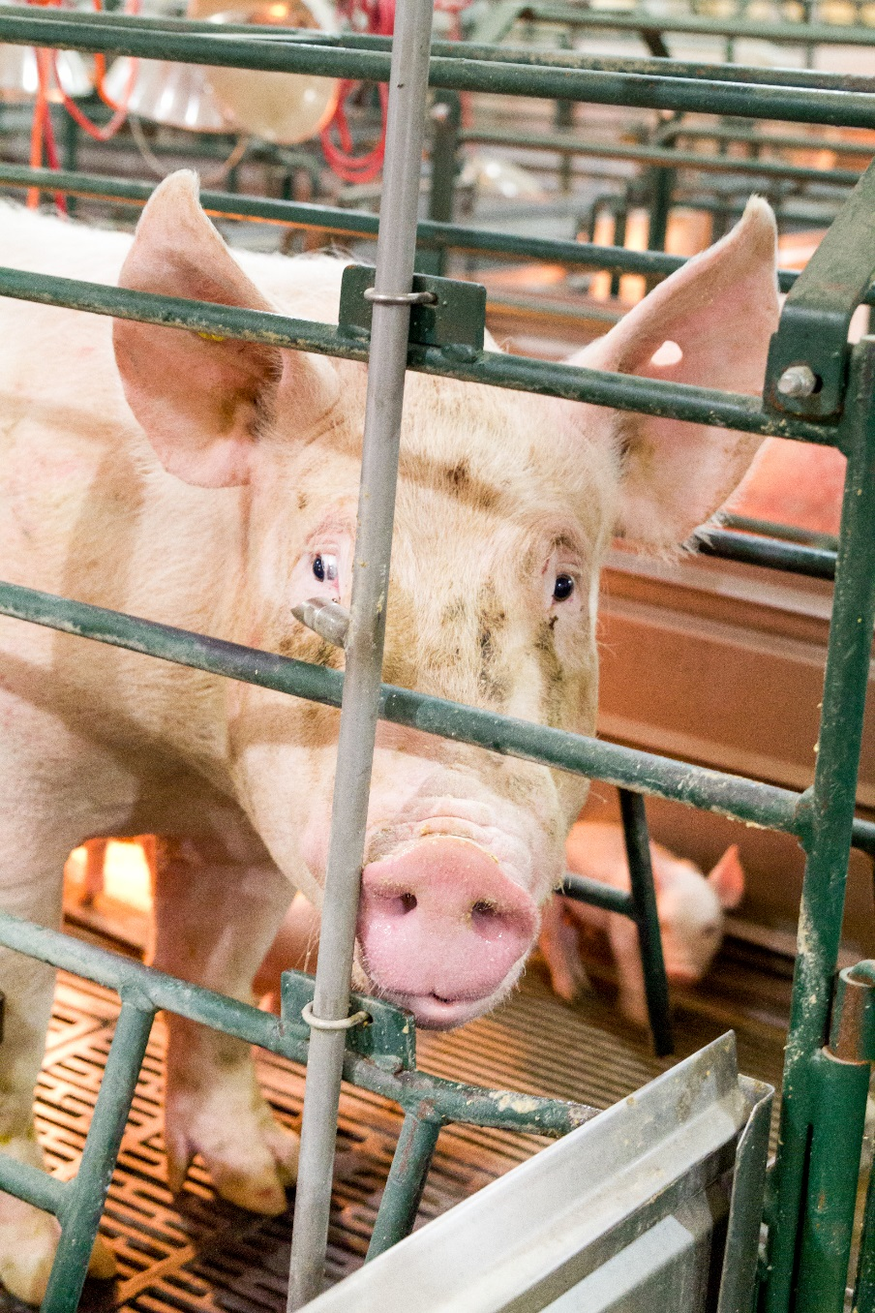
Weaning
Young pigs move to the next stage of production
Sows show:
  Behavioral signs
  Physical signs
The sow’s instinct
May stimulate her to protect her pigs
May becomes a safety hazard
Notes:
Weaning is an intense day for employees, but a proud day. The end product from all of the hard work is moving out of the door and onto the next stage. Many of the sows are starting to show behavioral and physical signs that they are ready for the pigs to move on. Even so, instincts may stimulate the sow to protect her pigs from you, the person moving them. Her instinct becomes a safety hazard.

Slide 3
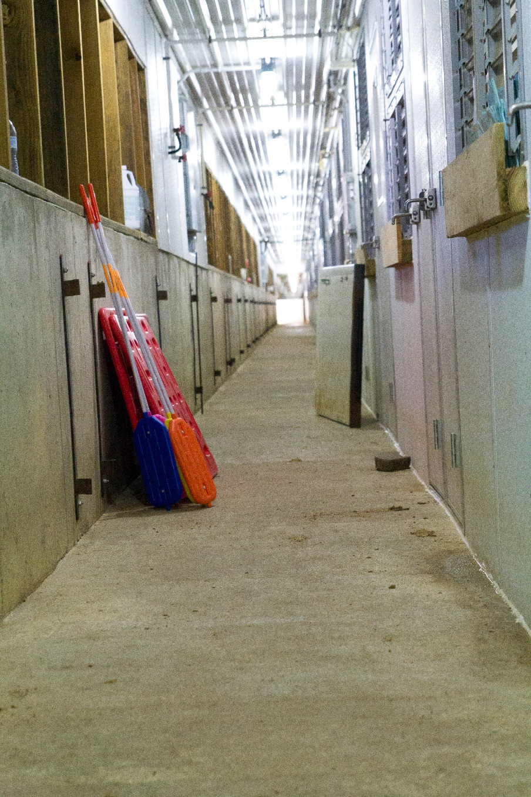
Removing the wean pigs
The handlers will be using our backs and legs, observing the environment for obstacles, and clearing the path for the pigs
  Be aware and prepared
  Make this potentially stressful experience as calm and safe as possible
Notes:
As we remove the piglets, we will be using our backs and our legs, observing the environment to watch for obstacles, clearing the path for the pigs. If we want to get these pigs out of the barn in a manner safe to us and good for the pigs, we must be aware and we must prepare. That is what this lesson is about . . . making this potentially stressful experience as calm and safe as possible.

Slide 4

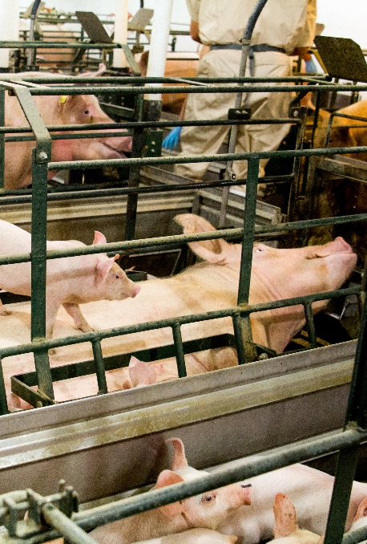
The farm must decide to
Wean the sow before they remove the pigs
Or
Wean the pigs before they remove the sow
There is not a right or wrong choice
Notes:
One decision the farm must make early on is whether or not to wean the sow before they remove the piglets or remove the sow after the piglets are released. There is not a right or wrong choice.

Slide 5
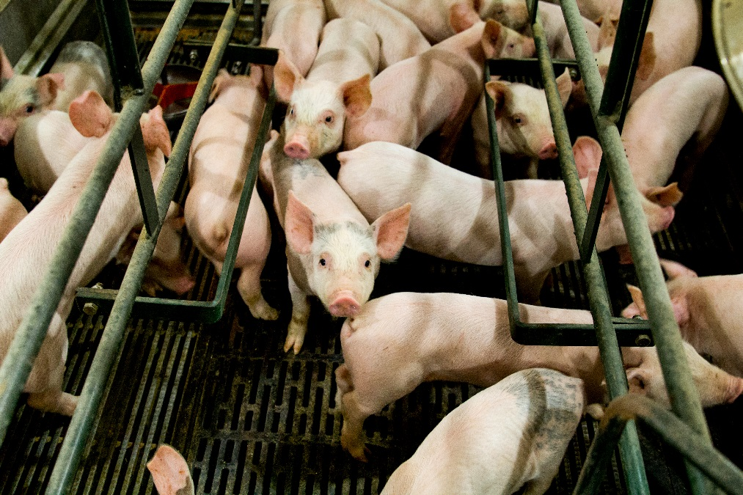
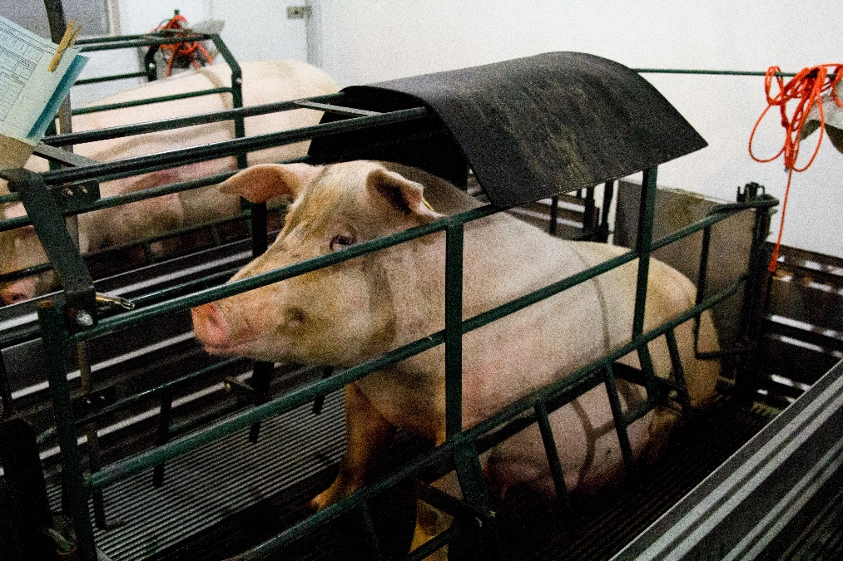
There are safety hazards for both decisions
If you remove the sow first
  She may not want to leave her pigs
  Be prepared for sows attempting to turn around and return to their pigs
If you remove the pigs first
  The sow may become agitated
  She may try to protect her pigs
  The sow gives the pigs less room to move
Notes:
But, there are safety hazards to be aware of with both decisions. If you remove the sow first, realize she may not want to leave her pigs. You must be prepared for sows, and especially younger ones, attempting to turn around and return to their pigs. On the other hand, when you wean with the sow in the stall, you must realize that the sow could become agitated and work to protect her pigs. One thing the presence of the sow does is gives them less space to run.

Slide 6
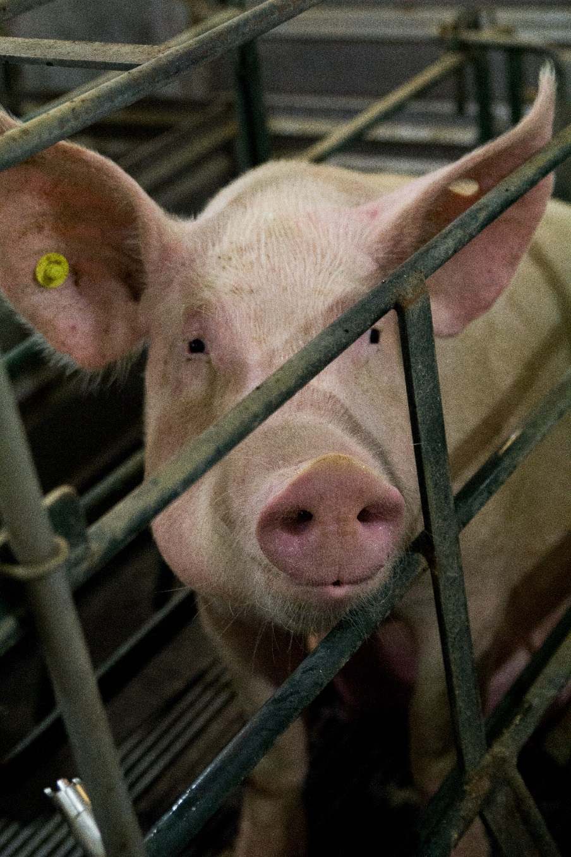
A sow is typically docile, but during weaning
She may become aggressive if she feels her pigs are threatened
Be mindful of your hand placement
An agitated sow may
Bite a hand resting on the bars of her stall
Lean against hands, arms and legs, pinning them between herself and the stall
Step on hands or feet
Notes:
Typically docile, a sow may become aggressive when she feels her piglets are threatened. Be mindful of the placement of your hands. A sow may bite a hand resting on the bars of her stall. She may lean against hands, arms and legs, pinning them between herself and the stall. A sow may also step on hands or feet.

Slide 7
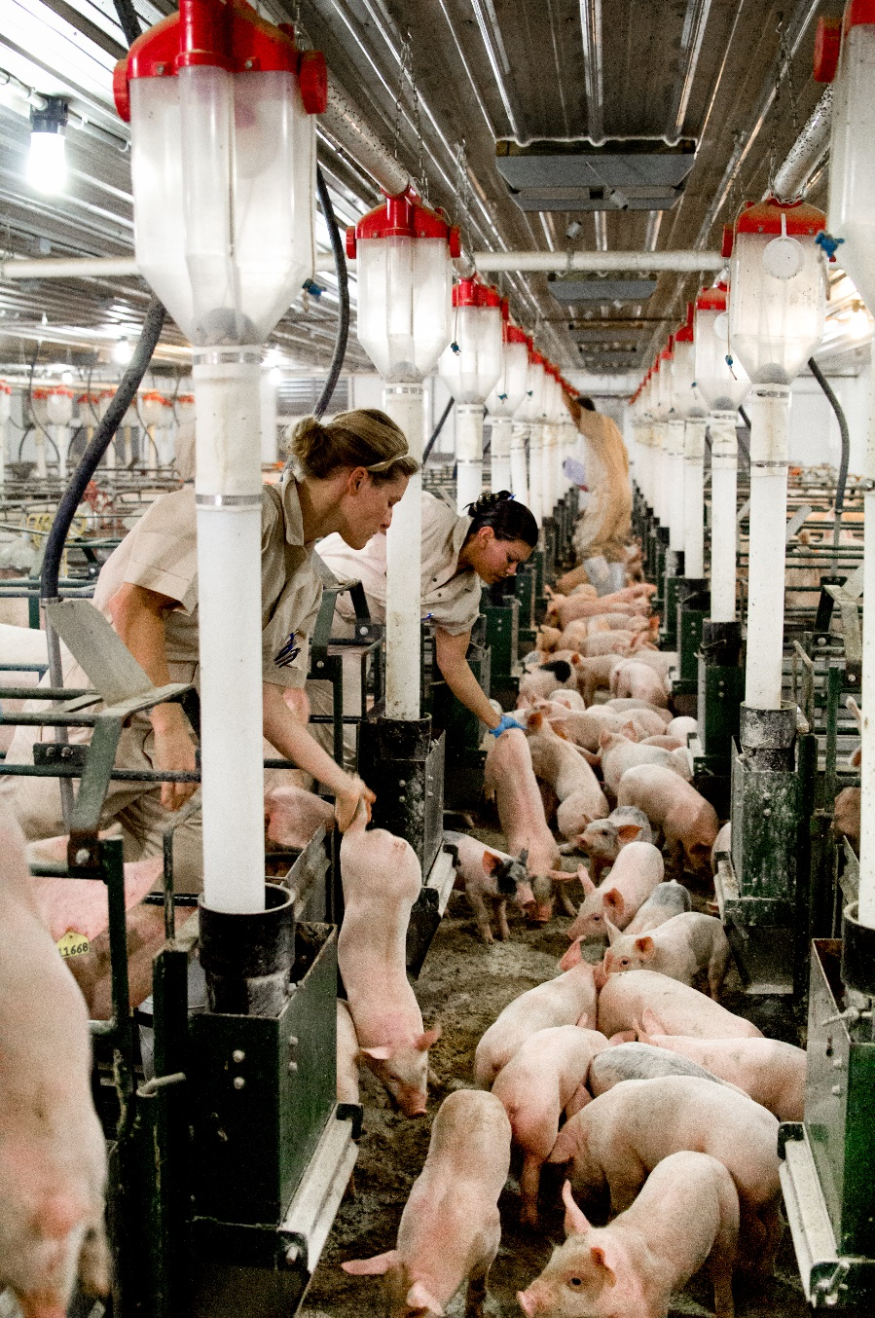
Weaning involves
Moving pigs from pen to alleyway
To safely and efficiently catch and wean pigs
Position two people on either side of the farrowing stall
Pigs
Are fast
Have sharp teeth
May squirm when being lifted
Be cautious when working around the sow’s head.
Notes:
Be cautious when working around the sow’s head. To safely and efficiently catch and wean pigs, there should be two people positioned on either side of the farrowing stall. Weaning involves moving them from pen to alleyway, and piglets are fast, have sharp teeth and may squirm when lifted.

Slide 8
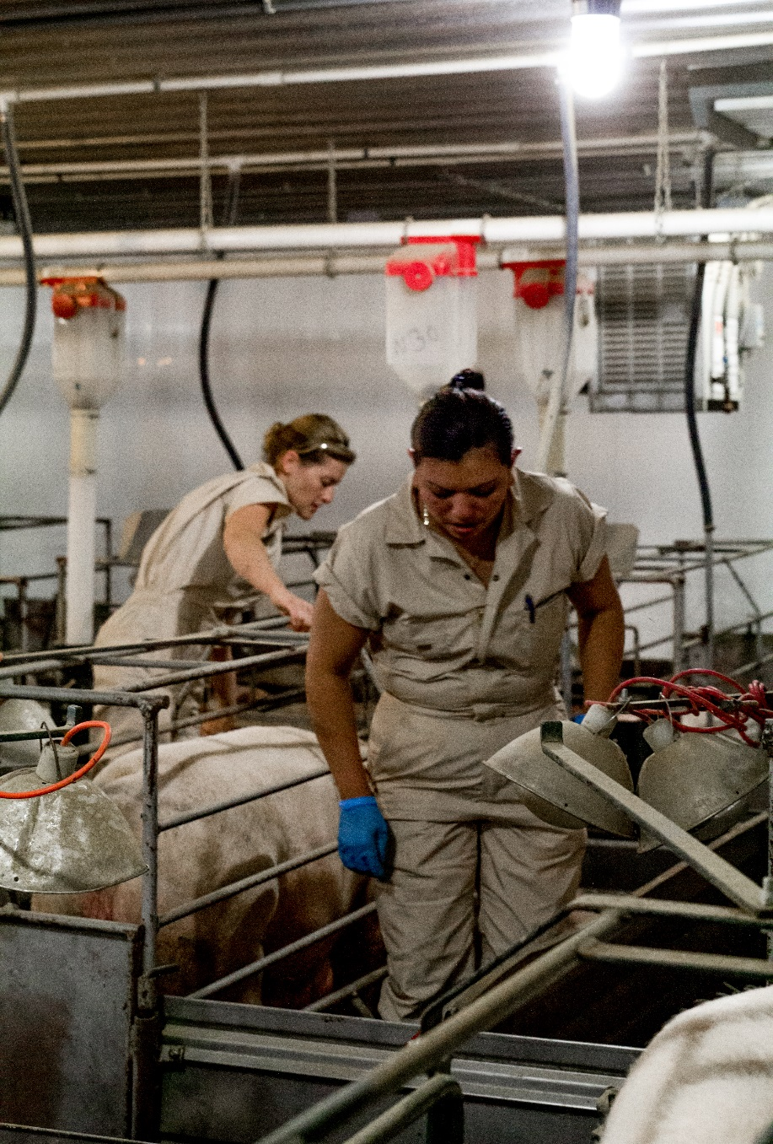
Employees should
Work together to wean the pigs
Be aware of their environment
  Power washer lines
  Heaters
  Heat lamps
    All could injure a person weaning pigs
Notes:
Notice how this team of employees works together to catch the pigs. The employees are also aware of their environment. In any barn, there are power washer lines, heaters, and heat lamps. All could injure a person weaning piglets if we are not careful.

Slide 9
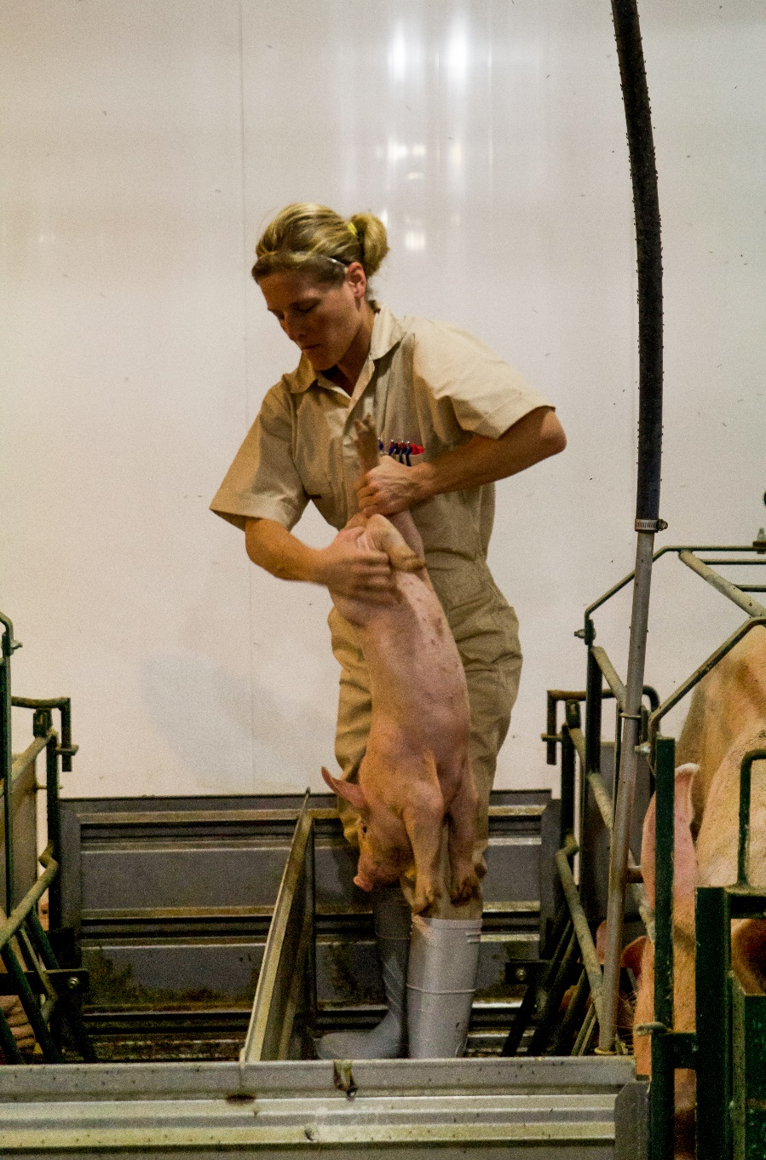
Catching pigs requires
Agility
Leg strength
Back strength
Follow safe lifting practices and never lift a pig that is too heavy for you
Notes:
Catching these pigs requires a certain amount of agility as well as leg and back strength. Follow safe lifting practices to prevent back injuries and never lift a pig that is too heavy for you.

Slide 10
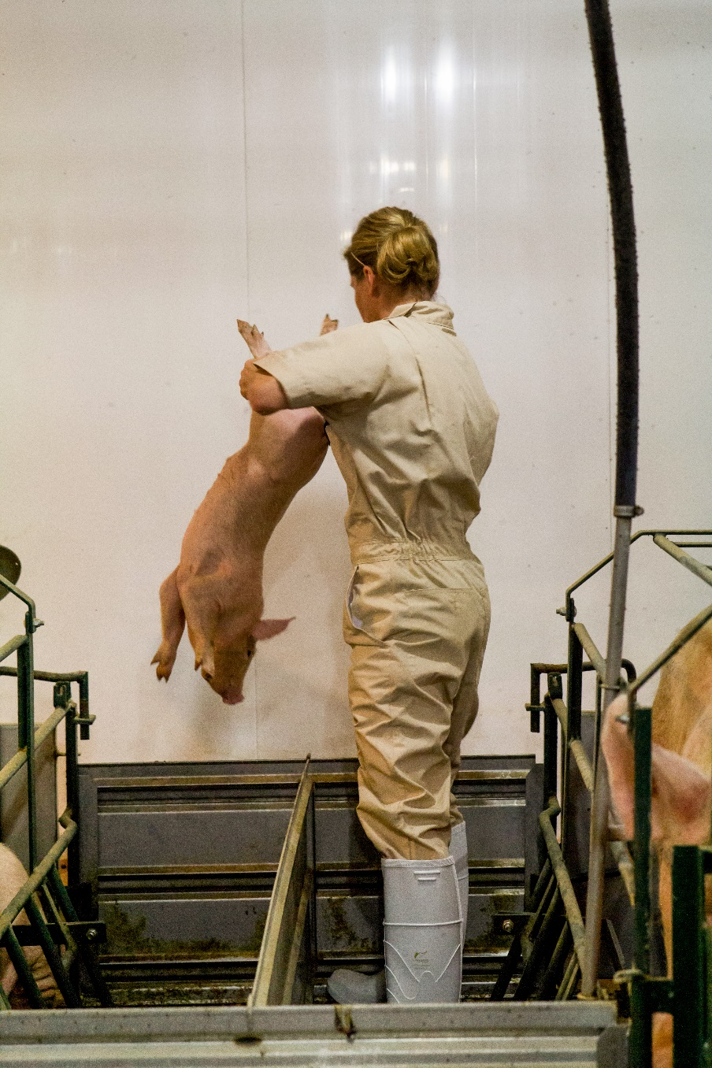
To properly catch a pig
Securely grasp the hind leg of the pig
  If the pig is heavy, use your other hand to grasp its other hind leg
Allow the pig’s front legs to help support its weight until it is in a vertical position
Lift the pig straight up to a height that will safely clear all gates and bars
If necessary, hold the pig under its ribcage to help support its weight
Notes:
Securely grasp the hind leg of the pig. If the pig is too heavy, use your other hand to grasp its other hind leg. Allow the pig’s front legs to help support its weight until it is in a vertical position. Lift the pig straight up to the height that will safely clear all gates and bars. If necessary, hold the pig under its ribcage to help support its weight.

Slide 11

Remember to always
Lift a pig with your arms and legs
Remember to never
Lift a pig with your back
Drop, throw or toss a pig
Release pigs until they have two points of contact with the ground
Notes:
Always lift a pig with your arms and legs, NOT your back. Never drop, throw or toss a pig. Do not release pigs until they have two points of contact with the ground.

Slide 12
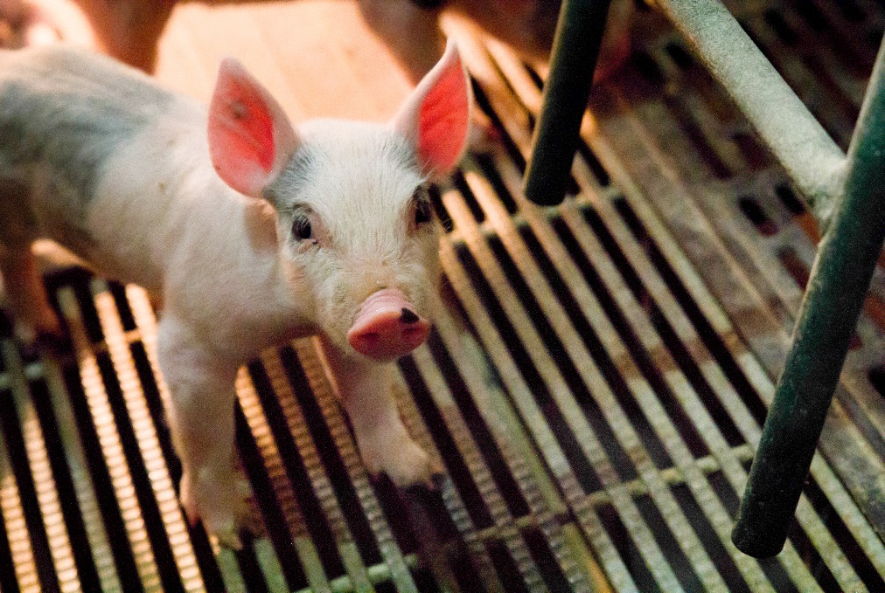
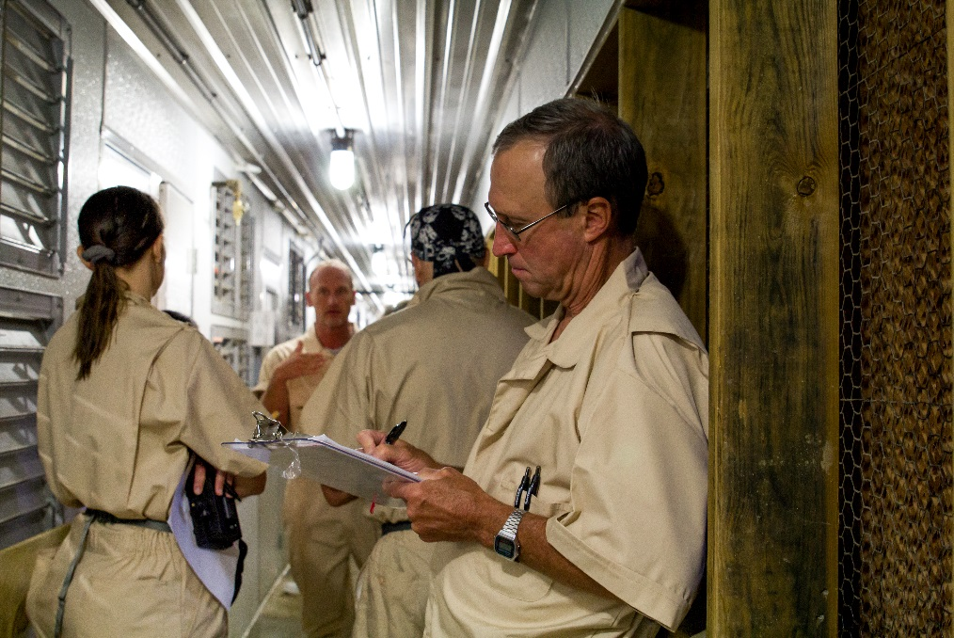
Weaning day is stressful for
Pigs
People
Preparing properly can make the event less stressful and safer
Notes:
Weaning is a big day and it is stressful for pigs and people. Preparing properly can make the event less stressful and therefore safer for all involved.

Slide 13
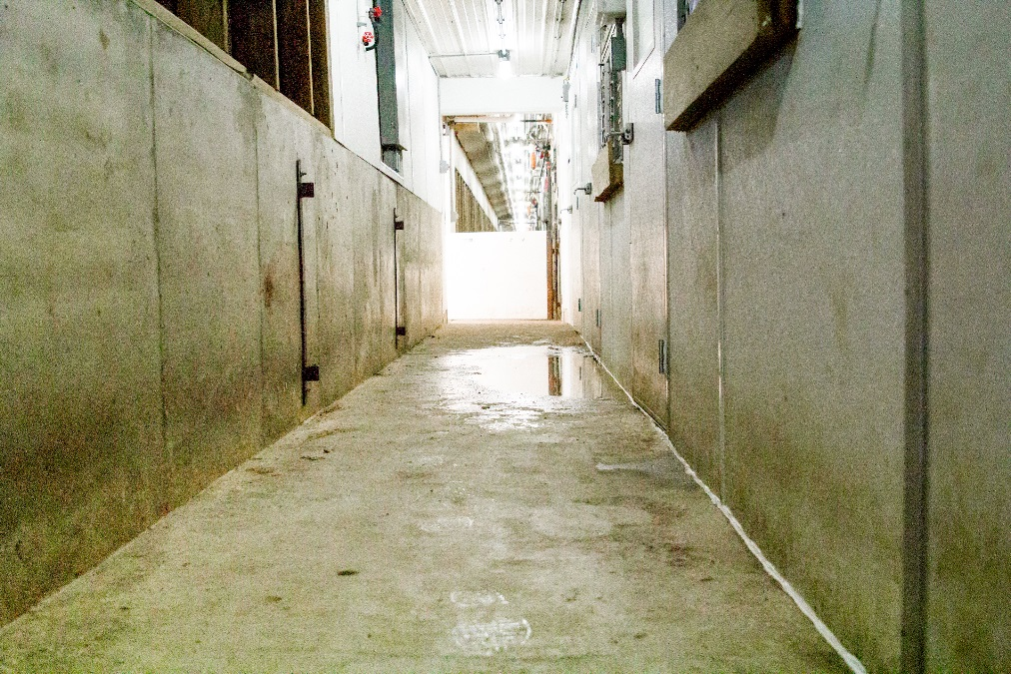
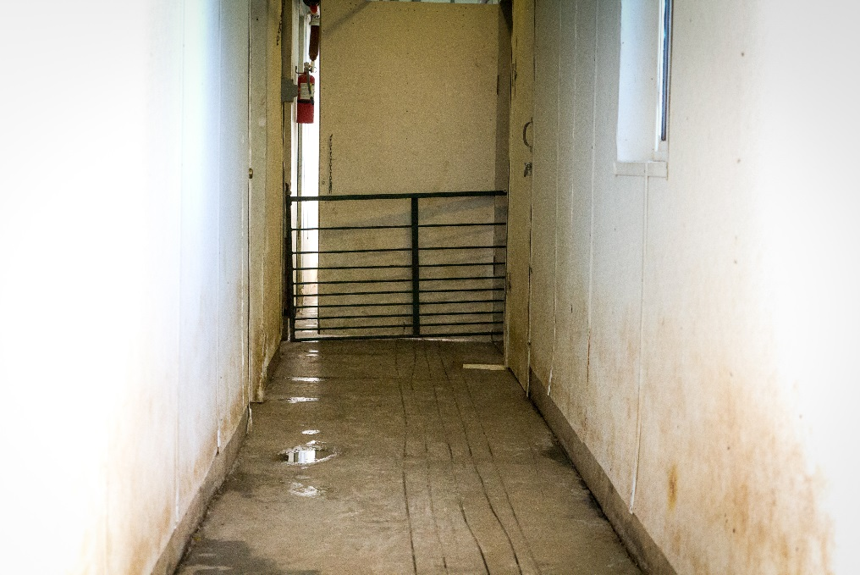
To prepare for weaning
Clear hallways of all hazards and distractions
Secure all gates along the path of movement
Have destination pen or trailer ready
Work to prevent potential distractions, including people flow
Notes:
Weaning is a big day and it is stressful for pigs and people. Preparing properly can make the event less stressful and therefore safer for all involved. Clear hallways of all hazards and distractions that could distract or trip pigs or people. Secure all gates along the path of movement and have the destination pen or trailer ready. Work to remove or prevent any potential distractions. This includes people flow.

Slide 14
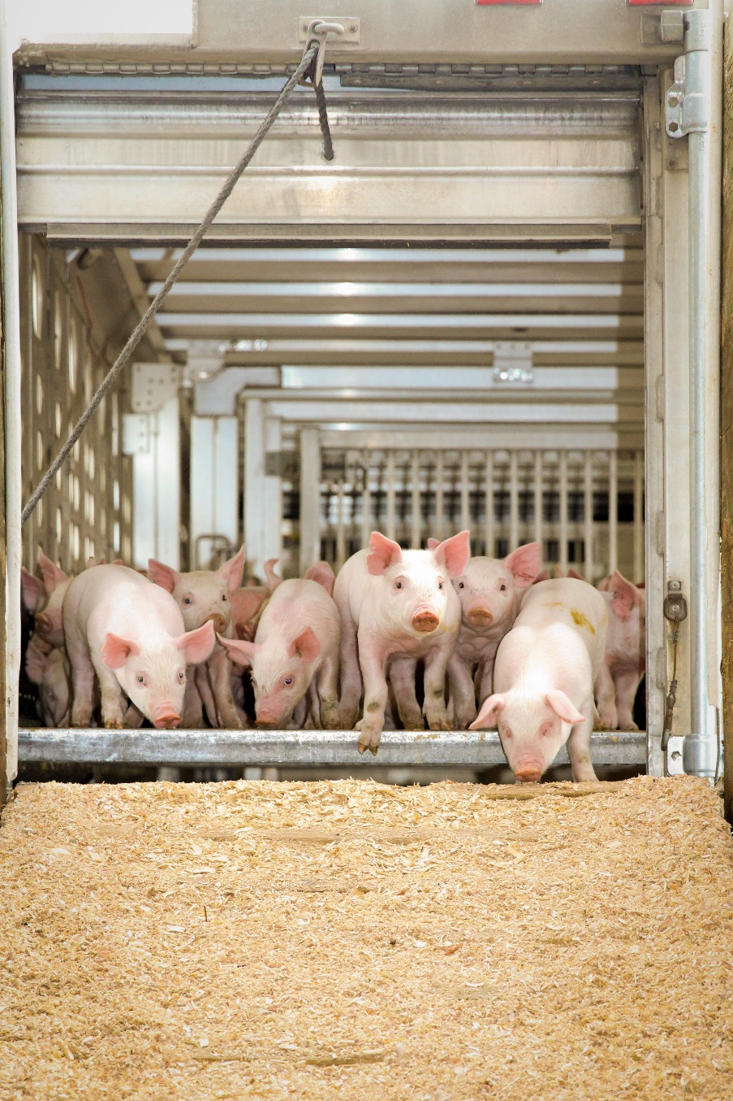
When wean pigs arrive on a truck, remember
They have traveled in a trailer under unfamiliar conditions
They may be scared and vulnerable
Notes:
It’s important to remember what these pigs have just been through. They have traveled in a trailer under very unfamiliar conditions. They are scared and vulnerable.

Slide 15
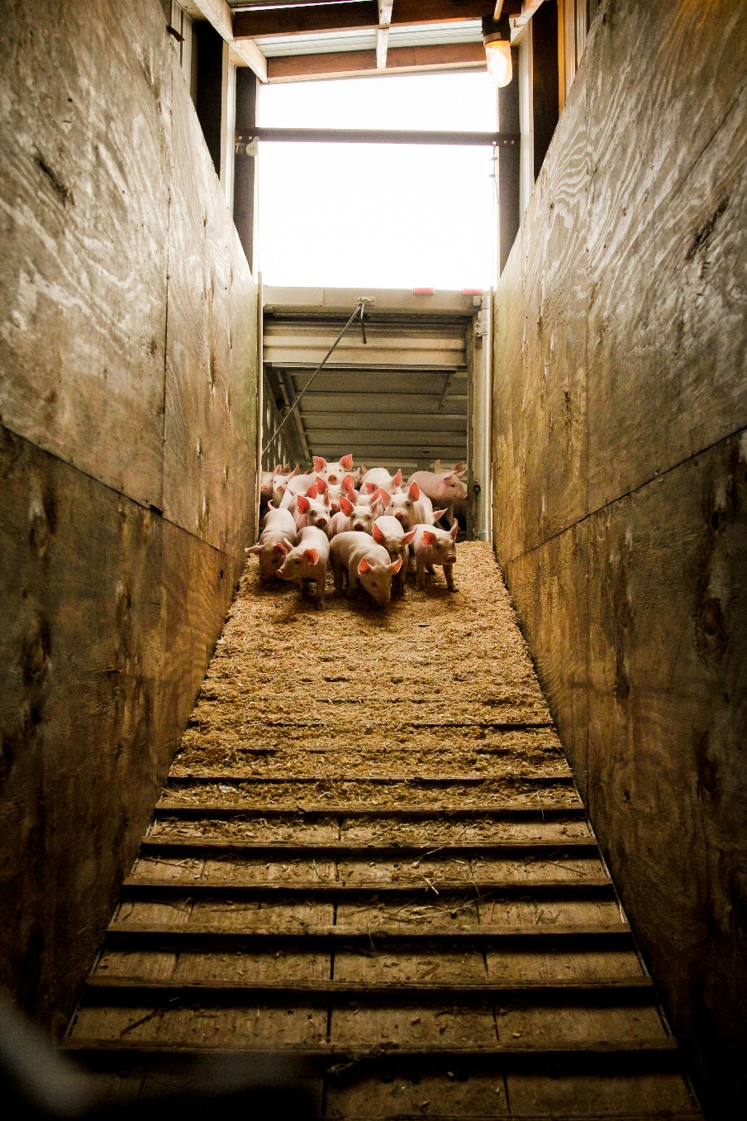
To minimize their stress as the process continues
Use their herding behavior to naturally move the pigs off the truck
  Avoid bunching
  Use their defensive response of circling to get them to their desired location
Stay calm and patient
Use irregular sound stimuli, not constant noise
Notes:
We must try to minimize the stress they are under as they continue the process. Use their herding behavior to naturally move animals off the truck. To avoid bunching, using their defensive response of circling to get them to their desired location. Stay calm and be patient. Irregular sound stimuli is better than constant noise as it will remain new and fresh for the animal and will be more effective.

Slide 16
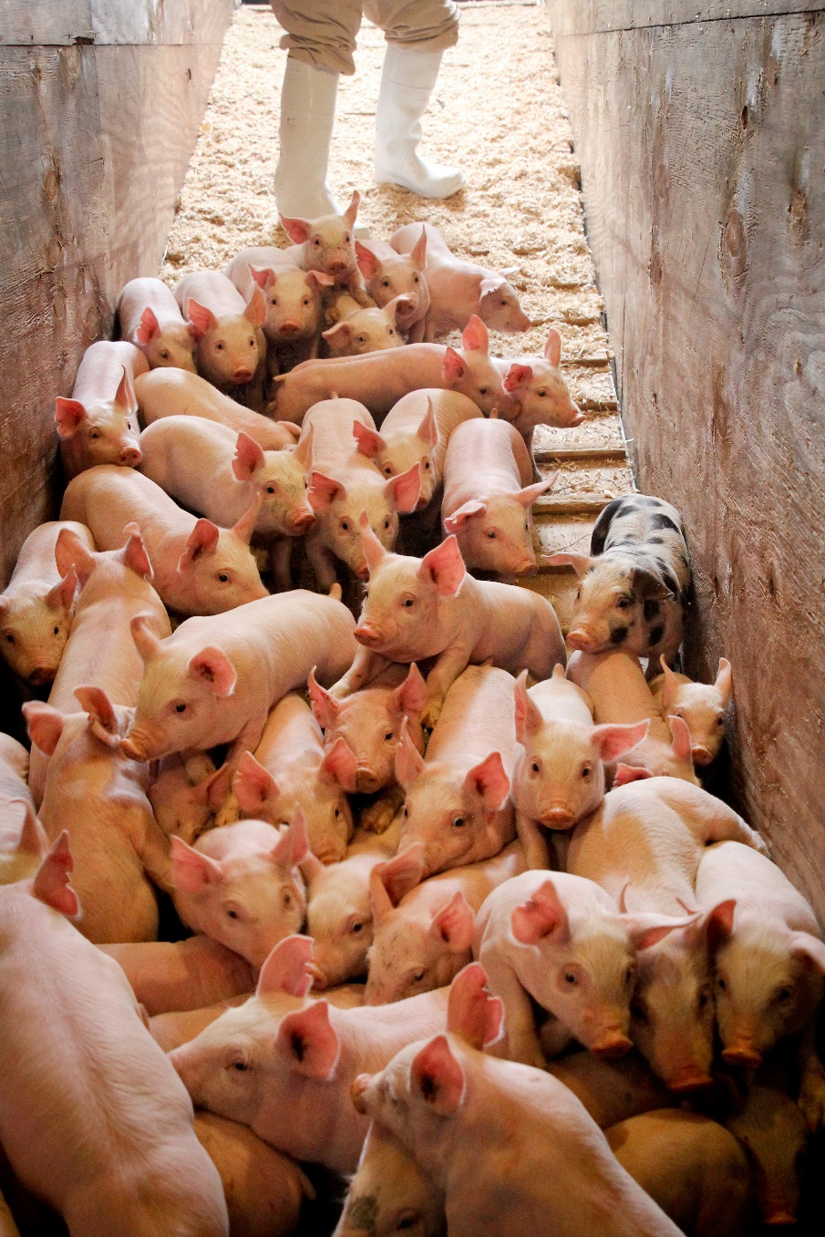
Transition from the truck to the barn
Exit off a chute
  Set chute up to provide proper footing
  Clear path of distractions and obstacles
  Allow pigs to walk on their own to avoid injury, slipping, and piling up
  Never push from behind
  Be sure the treads on the chute are spaced appropriately
Notes:
As the pigs transition off the truck to the barn, they will exit off of a chute. To keep this part of the process safest for the animal and crew and reduce the stress to all involved, the chute should be set up properly to provide sure footing and a clear path with no distractions or obstacles in the way. To avoid injury, slipping, and piling up, allow the pigs to walk on their own. Never push from behind. Be sure the treads are spaced appropriately.

Slide 17
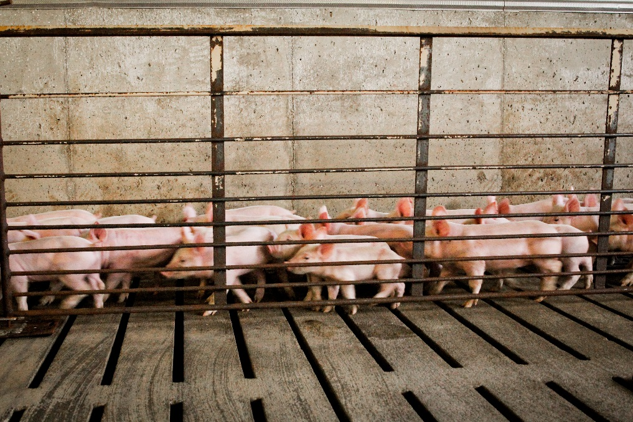
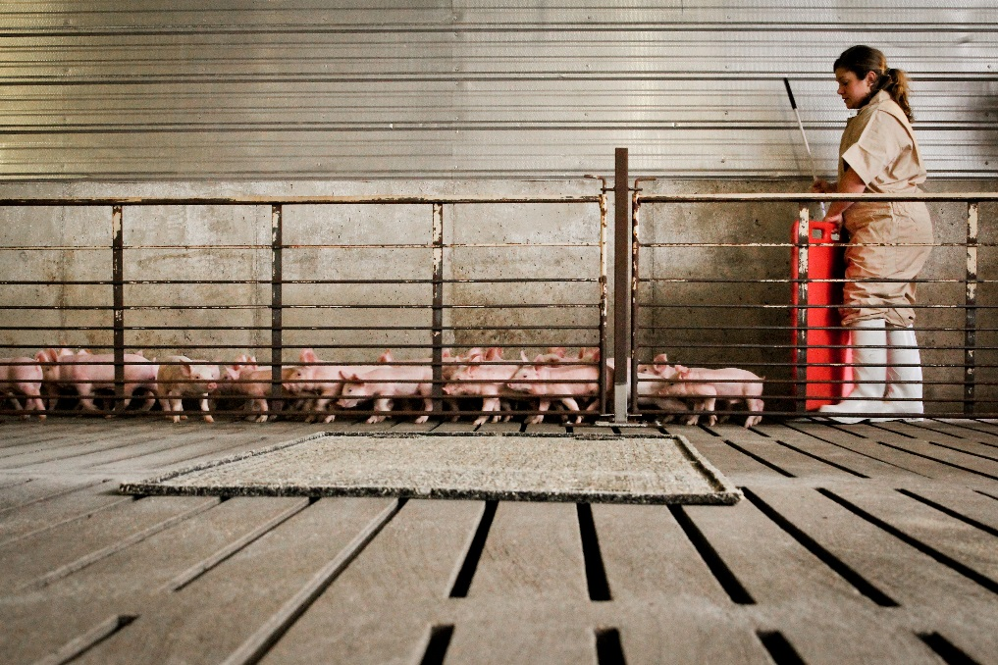
Transition from the truck to the barn continued
  Make sure the exit location is well lit
  Remove clutter and debris
  Have the significance of noise come from the handlers
  Make sure the environment is at a comfortable temperature
  Create curved paths whenever possible instead of sharp turns
Notes:
Pigs are more likely to move from a dark to light environment so it will help if your exit location is well lit. Pigs are easily distracted. Before movement down the chute begins, free their path from clutter or debris. The environment should be a comfortable temperature for the pigs so they have safe conditions. Whenever possible, create curved paths for movement or open alleys instead of sharp turns as the pigs will flow better when they can see where they are headed.

Slide 18
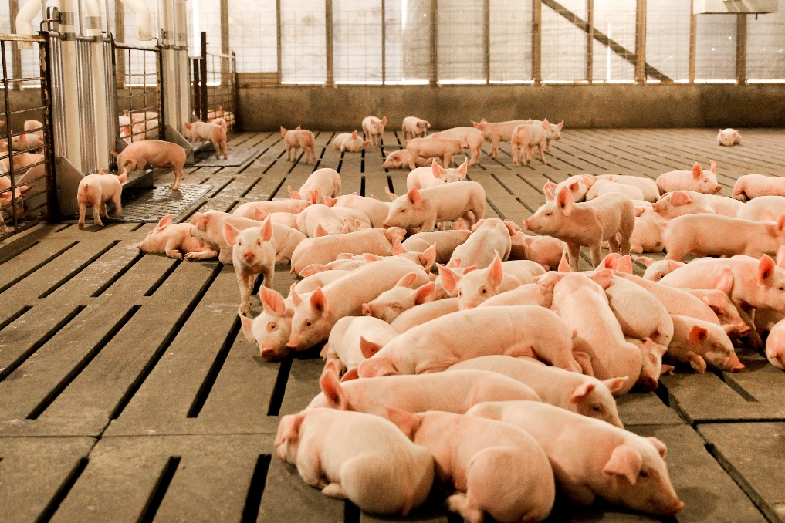
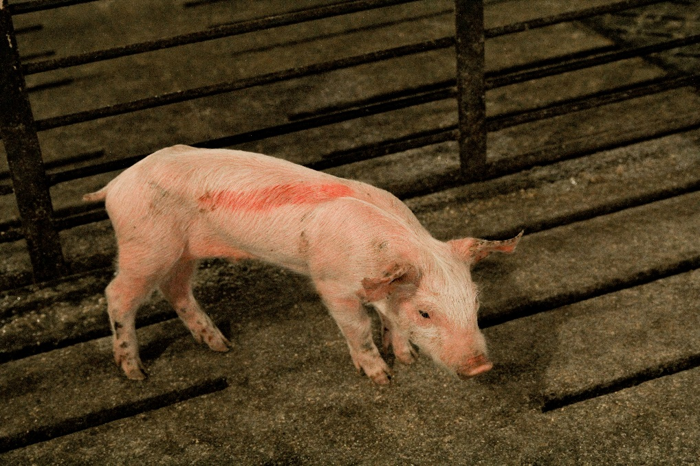
As pigs enter the barn
They will enter a large pen
They will be sorted by weight
  Fall-out pig = pig not getting enough nourishment and is losing weight instead of gaining weight or is injured
Handlers should
Look for fall-out pigs
Have pens available for them
Notes:
As pigs enter the barn, they will be put into a larger pen and then sorted by their weight. A fallout pig is a pig who is not getting enough nourishment and is losing weight instead of gaining or is injured. They appear weak or falling behind in the process. Handlers should be looking out for these fallout pigs and have hospital pens available for them.

Slide 19
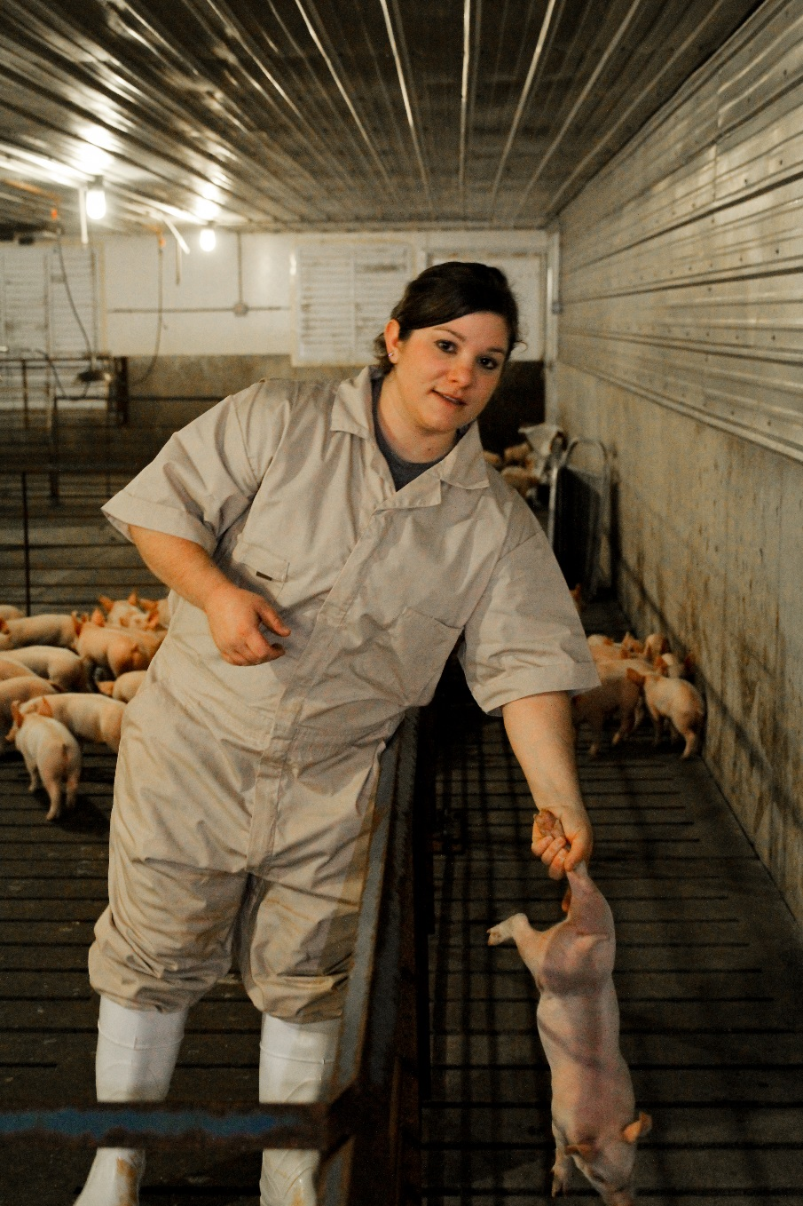
Picking up a smaller pig
Catch the pig by its back leg
Hold it with its head down and back legs pointing up
  The pig will be fully extended
  Do not twist a pig’s leg or pick it up by the front legs
  Never drop a pig into the pen or the alley
Notes:
When picking up a smaller pig, catch the pig by its back leg and hold it with its head down and back legs pointing up. The pig will be fully extended. Do not ever twist a pig’s leg or pick up from the front legs. Never drop a pig into its pen or alley.

Slide 20
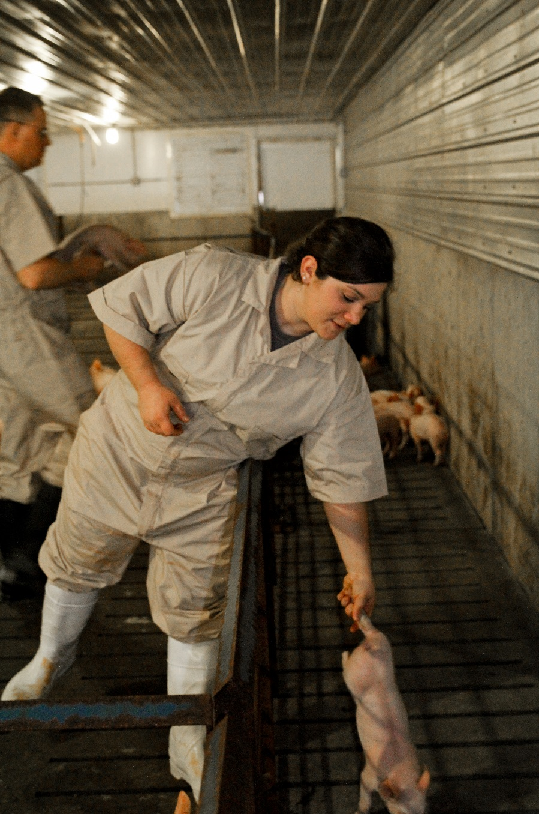
Setting down a smaller pig
Allow the pig’s front feet to touch the ground
Release its back legs carefully
The pig should be upright on four legs
Notes:
To set a pig down correctly, allow the pig’s front feet to just barely touch the ground. Release its back legs carefully and the pig should be upright and on four legs.

Slide 21
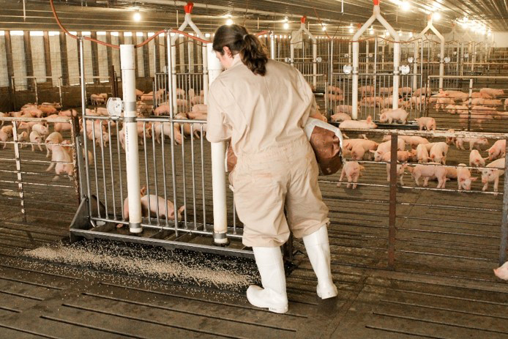
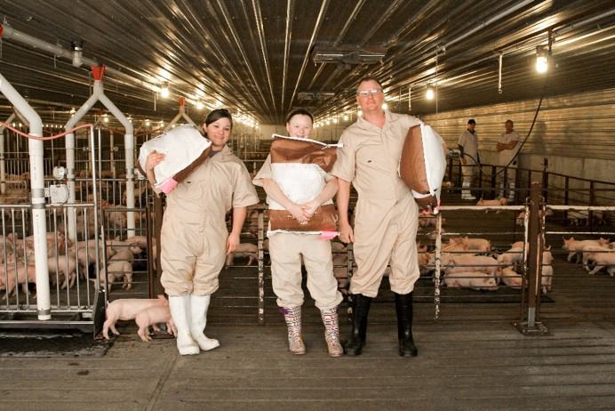
Feeding the pigs
An important part of the process
Should be done in a specific way to avoid injury to the handler
When lifting a feed bag
Always use your legs to do the lifting, not your back
When lifting a feed bag from a low lying area
Squat down to lift the bag
Stand straight up, taking pressure off the back
Notes:
Feeding the pigs is an important part of this process and should be done in a specific way to avoid injury to the handler. When lifting a feed bag, always use your legs to do the lifting, not your back. Be mindful if the bag is not evenly dispersed as it can become easily awkward. When lifting a bag from a low lying area, a handler should squat down to lift the bag and stand up straight, taking pressure off the back.

Slide 22
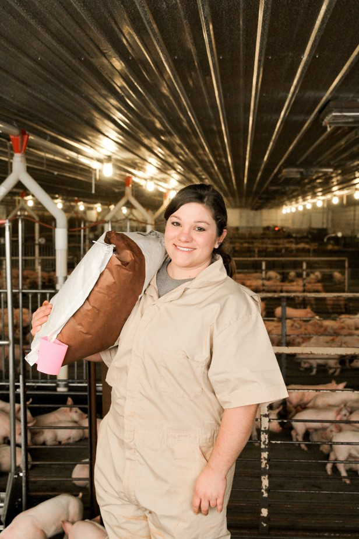
When getting a feed bag from an elevated position
Grasp the bag with both hands
Use your arms to lift
Use your body for stabilization
Notes:
When getting a feed bag from an elevated position, the handler should grasp with both hands and use their arms to lift, using their body for stabilization.

Slide 23
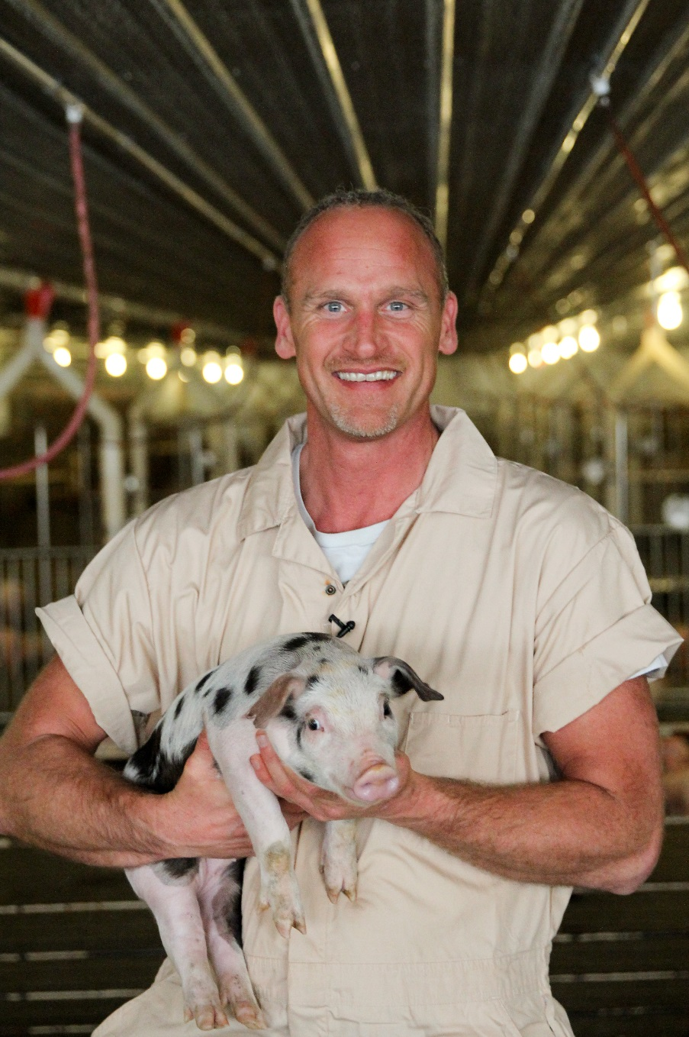
Smart handling is
safe handling
Notes:
Weaning pigs can be a stressful but very proud event. Remember to stay calm and be patient. Proper planning and preparation will help the day go smoothly, with minimal stress, for pigs and handlers alike.

