Slide 1
Pig Behavior
Handling
Fitness of Pig
Notes:
Understanding basic pig behavior and body language will help contribute to a safe and positive experience for the pigs and the handler.

Slide 2

Section Title
Key Topic
!
Notes:
These are some symbols you’ll see throughout the presentation.

Slide 3


Important Tips and Suggestions
Do this
And this
And this

Slide 4


Important Warnings and Cautions
Don’t do this
Or this
Or this

Slide 5
1. Pig Behavior
Notes:
Understanding basic pig behavior and body language will help contribute to a safe and positive experience for the pigs and the handler.

Slide 6
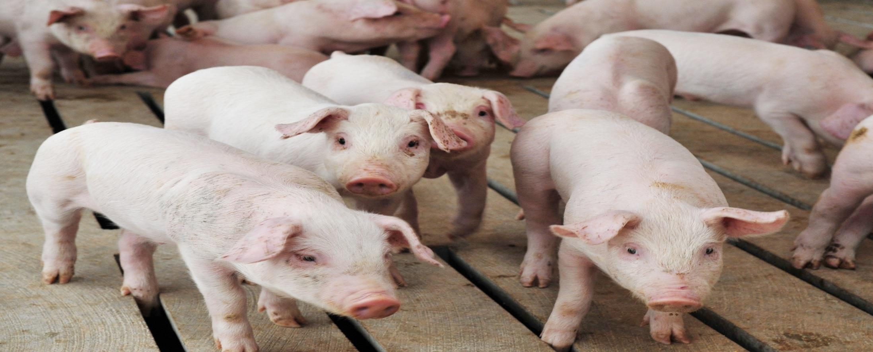
1. Pig Behavior
Section Objectives
Apply basic animal handling concepts, including animal behavior, the flight zone, and point of balance.
Recognize the importance of the animal handler's appropriate behavior as it relates to animal behavior.
Notes:
(Briefly review the objectives for this section.)

Slide 7
Basic Pig Behavior
1. Pig Behavior
Basic Pig Behavior
Instinctive behavior is influenced by
  Age
  Gender
  Health status
  Environment
  Prior experiences
Understanding basic pig behavior can help
  Make animal handling easier
  Reduce stress
  Reduce safety risks to the handler
  Reduce losses - skin injuries, bruises, fatigue, death
Notes:
Good animal handling practices start with the handler having a good understanding of pig behavior.
A significant portion of a pig’s behavior can be attributed to natural instinct and is further impacted by the age, gender, health status, environment and previous experiences of the pig.
(Animate)
Understanding a pig’s basic behavior can help:
Facilitate animal handling
Reduce stress
Reduce risks to a handler’s personal safety
Reduce losses due to skin injuries, bruises, fatigue, and even death
Calm pigs are easier to handle than excited, agitated pigs. Handling will be easier and pigs will be less likely to become agitated and bunch together if handlers use basic behavioral principles.

Slide 8
Individual Pig Perception and Response
1. Pig Behavior
Basic Pig Behavior
Three basic characteristics to consider:
  Flight Zone
  Point of Balance
  Senses – sight, hearing and smell
Notes:
An important part of effectively using pig behavior during handling procedures is learning how the pig perceives and responds to the handler in different situations and environments. There are three basic characteristics of the individual pig to consider:
Flight Zone
Point of Balance
Senses – sight, hearing, and smell

Slide 9
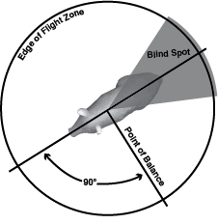
Flight Zone
1. Pig Behavior
Basic Pig Behavior
Safe distance from handlers
  Varies by pig
  Varies by situation
Recognize cues
Notes:
The flight zone is the area around an animal that it considers its individual space.
Pigs try to maintain a safe distance between themselves and their handlers. That safe distance varies between pigs, from moment to moment for each pig, and with even minor changes in handler behavior and body language.
The more threatening we are the greater the distance pigs want to keep from us. When a handler gets too close or too threatening, pigs get scared or defensive and their body language and behavior change. Handlers need to recognize cues that pigs are getting scared and release their pressure to let pigs calm down and stay responsive.

Slide 10
Point of Balance
1. Pig Behavior
Basic Pig Behavior
Used to determine which way to move away
  Varies with conditions
Avoid common errors
Notes:
The pig uses its point of balance to determine which way to move away from the handler as long as the pig has space to move away and the handler allows it to move away. Typically, the point of balance is located at a pig’s shoulder but this may change depending on the environment.
There are many conditions where the point of balance will not accurately predict how a pig will respond. There are situations where best results are achieved by working ahead of pigs and letting them circle past for example, as they move out a gate.
A common error handlers may make is attempting to move the pig forward while standing in front of the pig and tapping it on the rear or pressuring it to move forward. Also handlers should not move, block or interfere from a forward position when another handler is attempting to move pigs past them. Pigs may balk and refuse to move if they are driven towards visible people.

Slide 11
Senses of Hearing, Smell & Sight
1. Pig Behavior
Basic Pig Behavior
Relies on hearing and smell to situate itself, while sight is a complement
  Varies with conditions
Blind spot
Notes:
A pig relies on its sense of hearing and sense of smell to situate itself in its surroundings and uses sight to complement information gathered by these two senses.
The blind spot exists because a pig’s eyes are on the sides of its head and a pig’s field of vision is approximately 310 degrees leaving a blind spot directly behind it. Pigs want to see anything that is a potential threat or source of pressure. They try to keep handlers out of their blind spots. Pigs hold still and use their hearing to track people they can’t see. We have to notice what pigs are paying attention to in order to move them effectively. A pig’s sense of touch also plays an important role during handling.

Slide 12
Behaviors in Typical Handling Conditions
1. Pig Behavior
Basic Pig Behavior
The figure shows pig responses to specific set of conditions
Pig behavior will differ when
  In groups
  No chute to prevent turning around
  Confined spaces require working inside flight zones
  Multiple handlers are present
Notes:
The figure shows the flight zone, point of balance, and blind spot of an individual pig. This diagram illustrates a very specific set of conditions that are not always commonly found in barns or transport trailers.
For instance, when pigs are moving up a loading ramp, the point of balance will be at the shoulder but the flight zone should still be observed so the pig is not crowded and can get release from handler pressure.
Handlers inside barns and trailers typically work in conditions that are very different from those specified in the diagram:
Groups instead of individual pigs
No chute to prevent pigs from turning around
Confined spaces, such as pens and alleyways, that require handlers to work inside pigs’ flight zones and that limit pigs’ ability to move away from them
Other people involved during loading and unloading of pigs

Slide 13
Changing Conditions Changes Pig Behaviors
1. Pig Behavior
Basic Pig Behavior
Can’t rely on flight zones and point of balance alone
Need to understand how behavior is influenced by
  Herd behavior
  The presence of additional people
  Handlers’ use of pig handling tools
  Environmental influences
Notes:
Changing any of these conditions changes how pigs respond to us. When working: with groups of pigs, in confined spaces, with additional people present, pigs’ ability to move away from the handler is restricted. We can no longer depend on the point of balance and automatically assume that pigs will move away from our pressure to their flight zone. Instead, we need to understand how pigs’ behavior is influenced by their:
herd behavior
the presence of additional people
handlers’ use of pig handling tools
environmental influences
Each factor influences pig behavior independently and in combination with the others.

Slide 14
The Importance of Pig Body Language
1. Pig Behavior
Pig Body Language
Pigs tell us what they are paying attention to with their body language
Handlers should pay attention to
  Where pigs are looking
  How pigs are bending or twisting their bodies
  How pigs have their heads or ears turned or cocked
  Whether pigs are listening intently
Notes:
Pigs tell us what they are paying attention to with their body language, heads, eyes and ears. Specifically, handlers should note where pigs are looking, how they are bending or twisting their bodies, how pigs have their heads and ears turned or cocked, and whether pigs are listening intently.
Pig body language changes as they go from calm to highly excited. A good animal handler can read the pigs’ body language and adjust their own actions accordingly.

Slide 15
Releasing Pressure
1. Pig Behavior
Pig Body Language
Important to monitor body language and adjust the level of pressure you are applying
Ways to release pressure:
  Pause and let pigs move away
  Step back and refrain from making physical contact with them
  Soften our body language to reduce both our threat and the distance pigs require
  Let pigs circle past us: our strongest pressure is in the direction we are facing
  Discontinue making noise
  Look away from them
  Reduce group size
Notes:
Releasing pressure refers to any action that reduces the level of threat we pose to pig behavior. It often involves giving pigs more time and space. Some ways to release pressure are to:
Pause and let pigs move away
Step back and refrain from making physical contact with them
Soften our body language to reduce both our threat and the distance pigs require
Let pigs circle past us: our strongest pressure is in the direction we are facing
Discontinue making noise
Look away from them
Reduce group size – this is dependent on several factors such as pig size, aisle, door or chute width, environmental influences

Slide 16
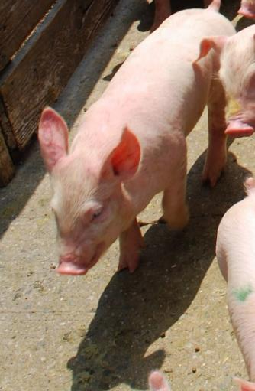

Calm Pigs
1. Pig Behavior
Pig Body Language
Body language indications:
  Head and ears low, body relaxed
  Moving at a walk or trot, (or exuberant outbursts if excited but not scared)
  Attention mostly forward
  Any vocalizations are low pitched
Continue to allow pigs to stay a safe distance from you and maintain release from your pressure
Notes:
We can group pig body language into a few categories that help you identify how you should react. This is the first category.
Pigs that are calm:
Head and ears low, body relaxed
Moving at a walk or trot, (or exuberant outbursts if excited but not scared)
Attention mostly forward
Any vocalizations are low pitched
(Animate)
Do:
Continue to allow pigs to stay a safe distance from you and maintain release from your pressure

Slide 17
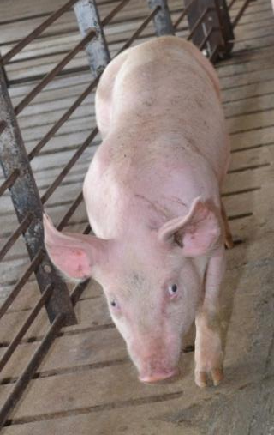

Pigs Showing Mild Fear or Defensiveness
1. Pig Behavior
Pig Body Language
Release pressure the animal will calm down
Body language indications:
  Heads and ears rising
  Still moving away but with increasing attention towards the handler
  Flight zone is expanding
  Possible brief increase in speed
Too close/not giving enough release from pressure
If you maintain or increase pressure, the animal may become fearful or defensive
Notes:
This is the second category.
Pigs showing mild fear or defensiveness:
Heads and ears rising
Still moving away but with increasing attention towards the handler
Flight zone is expanding
Possible brief increase in speed
(Animate)
Tip:
If you release pressure the animal will calm down
(Animate)
Warning/Caution:
Handler is getting too close / not giving enough release from pressure
If you maintain or increase pressure, the animal may become fearful or defensive

Slide 18
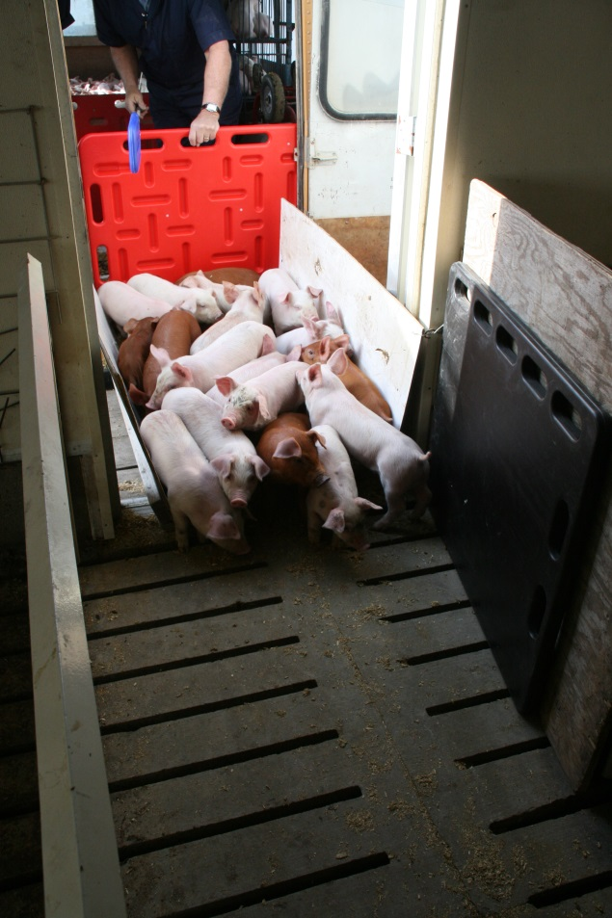
Pigs Showing Heightened Fear or Defensiveness
1. Pig Behavior
Pig Body Language
Release pressure the animal will calm down, but may require some time to do so
Body language indications:
  Full attention is on the handler
  Pig’s efforts to move away aren’t working so it switches to alternative tactics: stop, back up, turn back, try to get past the handler or…
  Shut down and refuse to move – a defensive response different from being too tame or fatigued
  Bunching up and difficult to sort or separate
Too close/too much pressure and pig can’t get release
If you maintain or increase pressure, the animal may escalate to extreme fear
Notes:
This is the third category.
Pigs showing mild fear or defensiveness:
Full attention is on the handler
Pig’s efforts to move away aren’t working so it switches to alternative tactics: stop, back up, turn back, try to get past the handler or…
Shut down and refuse to move – a defensive response different from being too tame or fatigued
Bunching up and difficult to sort or separate
(Animate)
Tip:
If you release pressure the animal will calm down but may require some time to do so
(Animate)
Warning/Caution:
Handler is too close / using too much pressure and animal is unable to get release
If you maintain or increase pressure, it may escalate to extreme fear

Slide 19
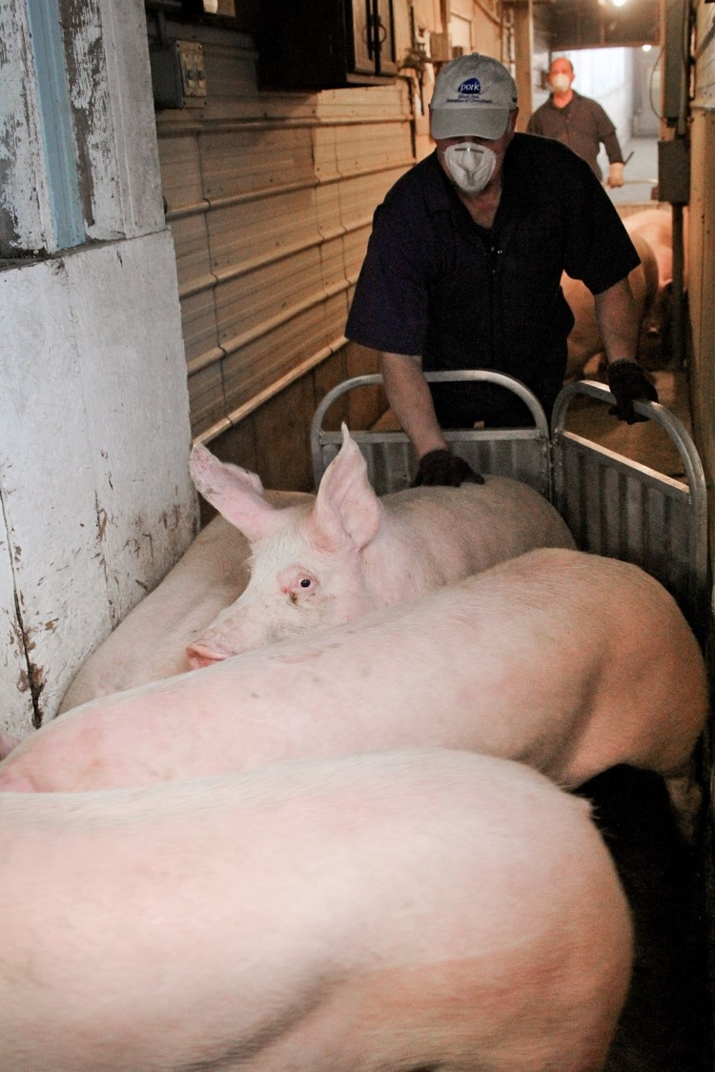
Pigs Showing Extreme Fear or Defensiveness
1. Pig Behavior
Pig Body Language
Body language indications:
  Panic
  Willing to run under, over, or through handlers and obstacles
  Scrambling, out of control movement
  High pitched vocalization
  Possibly leading to severe stress symptoms including death
  Bunching up and difficult to sort or separate
Notes:
This is the fourth and last category.
Pigs showing mild fear or defensiveness:
Panic
Willing to run under, over, or through handlers and obstacles
Scrambling, out of control movement
High pitched vocalization
Possibly leading to severe stress symptoms including death
Bunching up and difficult to sort or separate

Slide 20
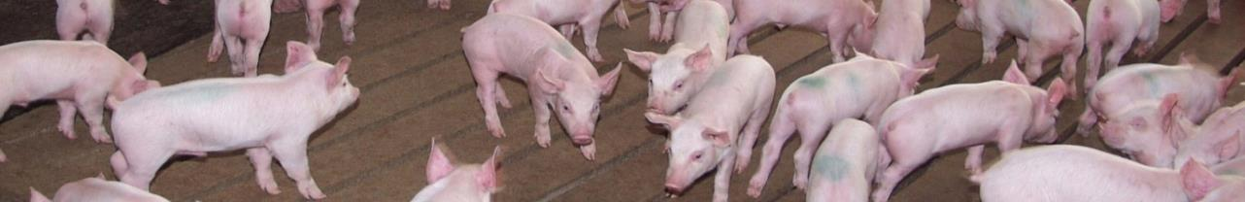
Herd Behavior and Group Patterns
1. Pig Behavior
Herd Behavior and Group Patterns
Pigs try to stay with other pigs for protection. Anytime we work with groups of pigs we get some form of herd behavior. The manner in which pigs display herd behavior is closely linked to their fear levels, what they are paying attention to, and available space.
Notes:
While the individual pig is important to observe, you should also examine herd behavior and group patterns.
Pigs try to stay with other pigs for protection, and you can expect herd behavior to be closely linked with their fear levels, what they’re paying attention to, and their available space.
The next few slides will look at herd behavior in more detail.

Slide 21
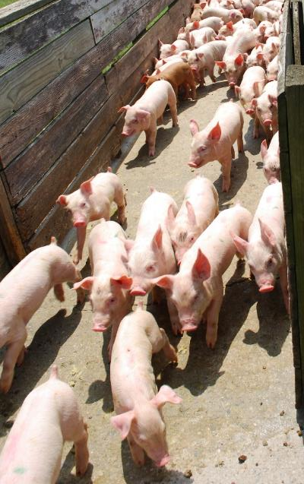
Flowing Herd Behavior
1. Pig Behavior
Herd Behavior and Group Patterns
When pigs move with a group that is moving. Occurs when:
  There is a calm pig response
  Pigs’ attention is on moving and staying with the herd
  Movement of front animals draws other pigs to join and follow
  Movement of animals coming behind drives front animals to continue moving forward
  Animals are loosely spaced
  The handler is moving with and not forcing the flow
Notes:
Movement occurs when pigs move with the group when the group is moving.
This flowing movement occurs when:
There is a calm pig response
Pigs’ attention is on moving and staying with the herd
Movement of front animals draws other pigs to join and follow
Movement of animals coming behind drives front animals to continue moving forward
Animals are loosely spaced
The handler is moving with and not forcing the flow. Pigs are being given time and space to clear obstructions, corners, etc. and move out of their space before the handler moves into it

Slide 22
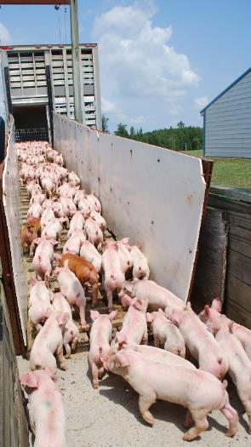
Disrupting Flow
1. Pig Behavior
Herd Behavior and Group Patterns
Take the time to minimize distractions in the environment before moving pigs and pay attention to what pigs are telling you
Movement or distractions can catch pigs’ attention and stop flow.
  Excessive handler noise, pressure and crowding from behind
  Something new or unfamiliar in the environment
  Sudden noises or movements
The most helpful thing a transporter can do to speed up loading is to stay still, stay quiet, and stay out of sight until the last pig gets past
Notes:
Sometimes, even when you have good herd flow, it can be disrupted. Movement and distractions ahead or to the side of the pigs can catch their attention and stop flow. Excessive handler noise, pressure and crowding from behind will also stop movement. Pigs may slow or stop flow when they encounter something new or unfamiliar such as changes in:
• Floor surface (e.g. transition from concrete alley to wooden chute)
• Footing/traction (e.g. wet, slippery chute or loose cleats)
• Temperature (e.g. moving from a warm building to an outdoor chute/ramp on a cold day)
• Lighting – pigs move best from dark areas to lighter areas, not from light to dark
Other things that may be unfamiliar or distracting and cause pig flow to slow or stop include:
• People in their path or peripheral vision area
• Drafts or wind – pigs may refuse to walk into a draft that blows into their face
• Shadows
• A beam of light shining through a crack or opening
• Equipment, trash or other objects in their path or hanging on gating (e.g. feed cart in alley)
• Loud or sudden noises and activity where they can hear but not see the source
• Water puddles or drain grates
• Shiny/reflective objects or surfaces
• Change in color of equipment/gates
• Change in height of flooring, a step up into a pen or chute, etc.
• Moving or flapping objects
• Doorways that may change the width of the alley
• Other animals (e.g. pigs, dogs, cats)
(Animate)
Tip:
Items on this list tend to cause problems for some handlers but not for others. Handlers who read their pigs, keep them calm, and give them time and space to flow tend to experience fewer difficulties. Take the time to minimize distractions in the environment before moving pigs and pay attention to what pigs are telling you. Signs of increasing fear indicate the handler needs to release pressure so pigs can settle down and continue flowing.
(Animate)
Tip #2:
Most handlers have experienced frustration while unloading because someone outside the trailer is receiving, counting, auditing, tattooing, moving pigs, or doing other things, and blocking pigs from moving off the trailer. When pigs are being loaded onto a trailer, the transporter is the receiver. People bringing pigs to the trailer get annoyed when they see a face looking back or hands and tools in sight, moving around, reaching in, making noise, and stopping their pigs. The most helpful thing a transporter can do to speed up loading is to stay still, stay quiet, and stay out of sight until the last pig in the group gets past.

Slide 23
Flow and the Number of Handlers
1. Pig Behavior
Herd Behavior and Group Patterns
Pigs try to keep track of all people
Only one person should be pressuring pigs at any time or you risk disrupting flow
  Drawing attention and stopping pigs that have already gone past
  Blocking pigs that are approaching so they stop moving or stop driving the front pigs forward
  More forceful handling from an annoyed loader and that in turn leading to more problems and longer load time
The fewer people present, the simpler it is for pigs to keep moving and the easier it is for handlers
Notes:
It is important that only one person pressure pigs at any time. When someone is behind a group of pigs driving them towards you, anything you do could encourage the pigs to stop and turn back. Pigs have to be moving to get to the trailer and our best tool is to let that flow keep moving them into the trailer.
Any noise or activity from the handler risks:
Drawing attention and stopping pigs that have already gone past
Blocking pigs that are approaching so they stop moving or stop driving the front pigs forward
More forceful handling from an annoyed loader and that in turn leading to more problems and longer load time
Pigs try to keep track of all people. Observers and people not actively involved with moving pigs can also draw pigs’ attention and stop movement. The fewer people present, the simpler it is for pigs to keep moving and the easier it is for the people moving them.

Slide 24
Bunching Herd Behavior
1. Pig Behavior
Herd Behavior and Group Patterns
When the group stops and pigs stay together
  Is a defensive response
  Kills movement which may be useful for ear tagging and vaccinating
  Is encouraged by anything that stops, crowds, traps or confuses pigs
  Often occurs when pigs are facing away from the handler, closely packed, and listening intently
Increasing pressure and aggressiveness towards pigs that are bunching encourages tighter bunching.
Notes:
When pigs do stop and stay in a group, we call this bunching.
Bunching:
Is a defensive response
Kills movement which may be useful for ear tagging and vaccinating
Is encouraged by anything that stops, crowds, traps or confuses pigs
Often occurs when pigs are facing away from the handler, closely packed, and listening intently
An early warning is heads and ears rising and increased crowding within the group.
(Animate)
Pigs will often stay in a bunch rather than leave the bunch to get away from the handler. Increasing pressure and aggressiveness towards pigs that are bunching encourages tighter bunching. One of our main priorities when moving pigs is to avoid having pigs bunch.

Slide 25
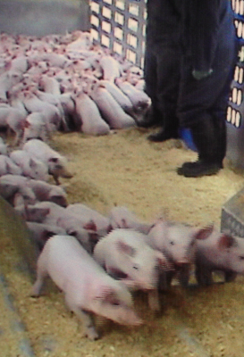
Handler’s Bubble
1. Pig Behavior
Herd Behavior and Group Patterns
The safe distance pigs try to maintain between themselves and the area around a handler. The bubble:
  Takes up “real” space and contributes to crowding
  Expands and contracts with the handler’s pressure and pigs’ fear levels
  Acts as a “real” barrier that moves with the handler
Notes:
We can look at the safe distance pigs try to maintain between themselves and a handler as either a flight zone around the pig or as a bubble around the handler.
The bubble:
Takes up “real” space and contributes to crowding
Expands and contracts with the handler’s pressure and pigs’ fear levels
Acts as a “real” barrier that moves with the handler

Slide 26


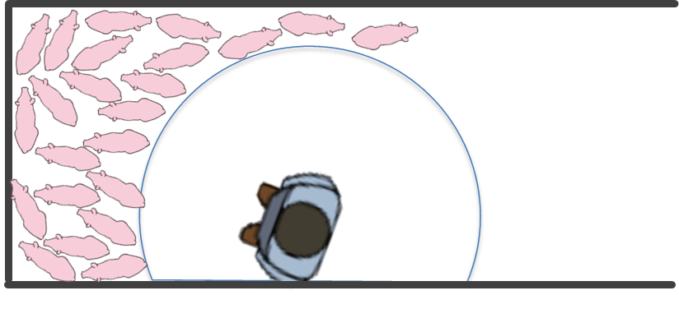

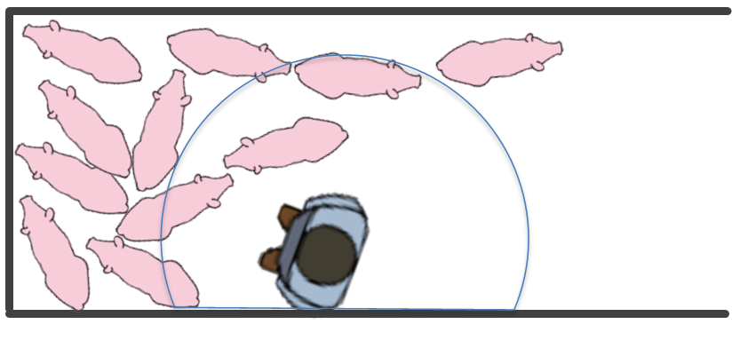
Handler’s Bubble & Circling
1. Pig Behavior
Herd Behavior and Group Patterns
Notes:
Pigs tend to move along the arc of the bubble. By watching where the bubble is taking pigs, handlers can adjust their position so their bubble takes pigs where they want them to move.
(Animate) In crowded conditions, such as when starting movement out of rear compartments, smaller pigs will tend to pile away to get out of the bubble then turn back to circle.
(Animate) Larger animals such as market pigs and breeding stock are more likely to hold still within the bubble. With larger animals, you want to start moving animals that are facing the right direction and use their movement to pull others.
Circling: pigs circle their handlers to get release from pressure. This is a defensive response. Circling is a valuable tool when used intentionally in conjunction with the handler’s bubble to sort pigs, start movement, speed up movement, shift pigs’ attention from the handler to herd flow, move pigs past barriers, and funnel movement to prevent stopping and bunching at gates.

Slide 27

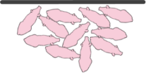
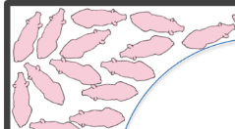
Summary of Group Movement Patterns
1. Pig Behavior
Herd Behavior and Group Patterns
GROUP PATTERN | EMOTIONAL STATE | EFFECT ON MOVEMENT | PRESSURE and/or RELEASE | ATTENTION & RESPONDING TO
FLOW | Calm | Easiest movement | Being given release | Herd movement
BUNCH | Fearful or Defensive | Kills movement | Blocked from getting release | Handler
CIRCLE | Fearful or Defensive | Opposite direction of pressure Accelerates | Taking release by circling out of handler’s pressure | Handler
Notes:
This chart is a useful summary of group movement patterns in pigs. Being able to recognize flow, bunching and circling and knowing how to respond in order to influence pig behavior is key to effective handling.

Slide 28
Taking Stock
1. Pig Behavior
Herd Behavior and Group Patterns
Instead of using fear to make pigs move:
  Use the least amount of pressure necessary to start movement then give release
  Use herd movement to pull pigs whenever you can
  Use your position and bubble to prevent bunching herd behavior and encourage flow
Calm animals move in a controlled manner
Defensive and anxious pigs are more difficult to move
Turning back, balking, refusing to move, and trying to get past the handler are fear responses triggered by handlers not giving pigs time and space to respond
Notes:
Many people equate “flight” with scared animals running away, but by keeping pigs calm they will move away in a calm controlled manner.
The confined space of trailers and unfamiliar activities can make pigs defensive during loading and increase their tendency to either circle or bunch. Making pigs more anxious intensifies these responses and makes them harder to move. Instead of using fear to make pigs move:
(Animate)
Use the least amount of pressure necessary to start movement then give release to:
let pigs stay calm
allow pigs to shift their attention away from you so they can move away from you or join the movement of other pigs.
Use herd movement to pull pigs whenever you can
Use your position and bubble to prevent bunching herd behavior and encourage flow
(Animate)
Turning back, balking, refusing to move, and trying to get past the handler are not displays of pigs’ defiance, excessive tameness, or ignorance. These are fear responses triggered by handlers who are not giving the pigs the time and space they need to respond safely. Many pig handling problems attributed to environmental factors are actually caused by handlers working too aggressively.

Slide 29
2. Handling
Notes:
The next section focuses on handling. Using proven pig handling and movement practices will help contribute to a safe and positive experience for the pigs and the handler. Human injuries happen more often when people are handling animals than during any other activity performed in pork production.
Common handler injuries when moving pigs are contact injuries, slipping and falling, head cuts, or bumps and bruises when on the trailer. Using proper handling practices and using proper handling equipment will help animal handling be a safe activity for all.

Slide 30
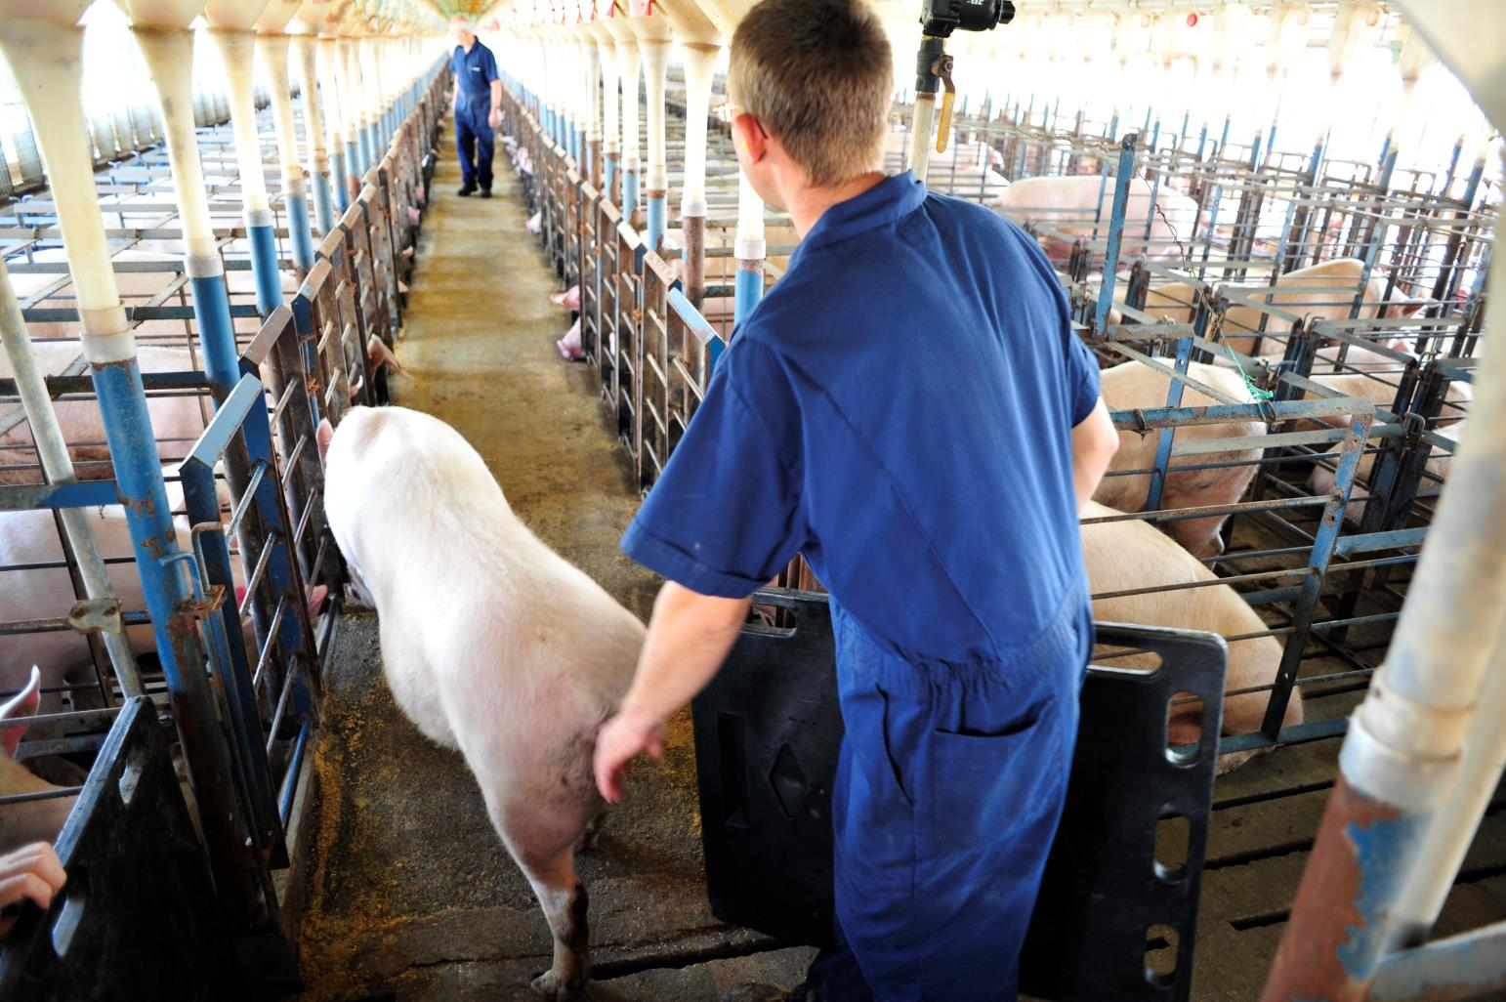
2. Handling
Section Objectives
Apply basic animal handling concepts including the acceptable use of appropriate tools and handling aides.
  Describe the potential effects that human interactions have on pigs and pig behavior, as well as interactions with other individuals.
  Explain specific techniques to use when handling and transporting pigs of various sizes/types of pigs including; breeding stock, culls, weaners and grow-finish pigs, and the differences between them. Identify the tools and techniques to use when handling each type of pig.
Describe the influence handling techniques and animal handlers have on the incidence of dead and injured, ill, or fatigued animals.
Discuss worker safety protocols related to animal handling and transportation. Evaluate potential safety risks and identify any required personal protective equipment (PPE) to be used.
Notes:
(Briefly review the objectives for this section.)

Slide 31
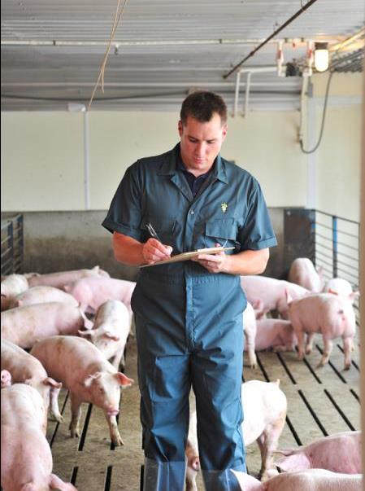
People: Pig Interactions
2. Handling
Pigs may not understand a handler’s intentions
Pigs experiencing positive interactions are typically
  Less fearful of handlers
  Easier to handle
Notes:
It is important to understand the potential effects that human interactions have on pigs and pig behavior. A person’s intentions are not always understood by the pig and this may create fear and/or a negative reaction to a handler. Additionally, pigs that have had regular, positive interactions with people will typically be less fearful and easier to handle.

Slide 32
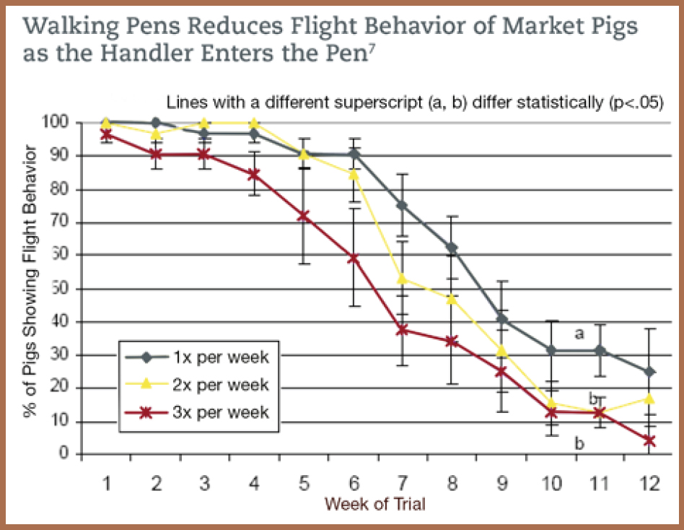
Walking the Pens Reduces Flight Behavior of Market Pigs as the Handler Enters the Pen
Handling
Notes:
Slowly walking pens on a daily basis will help pigs become used to positive interactions with people as this graph shows. Regular interaction will train the pigs to quietly get up and calmly move away from the handler.
Pigs can recall previous experiences and if they have had a bad handling experience in the past they may be more difficult to handle the next time. This previous experience may relate specifically to a human interaction or it may relate to a piece of equipment such as a loading chute.

Slide 33
Proper Handling
Handling
Move pigs at their normal walking pace
Avoid aggressive handling:
  Overuse, or improper use, of electric prods
  Loud noises and yelling
  Moving pigs too fast
  Moving too many pigs per group
  Overcrowding pigs in chutes, ramps and alleyways
  Rough physical contact
Willful acts of abuse are unacceptable
Requirements differ for certain sizes and types of pigs
Notes:
Handlers should act calmly and avoid sudden movement, loud noises and other actions that may frighten or excite pigs. This includes shouting or creating excessive noise with other handlers when working as a team to move pigs.
Pigs should be moved at their normal walking pace. Aggressive handling should be avoided as it can lead to injured or stressed pigs. Research indicates that more than 20 percent of aggressively-handled market pigs can become injured, stressed or fatigued compared to 0 percent of those handled properly.
Aggressive handling includes things such as:
• Overuse, or improper use, of electric prods
• Loud noises and yelling
• Moving pigs too fast
• Moving too many pigs per group
• Overcrowding pigs in chutes, ramps and alleyways
• Rough physical contact
Willful acts of neglect or abuse are unacceptable. Each state has laws that address animal cruelty, and, therefore, willful acts of abuse can be punishable by law. Willful neglect and abuse are defined as acts outside of normally accepted production practices that intentionally cause pain and suffering. This includes, but is not limited to, malicious hitting, beating an animal, or using an electric prod in sensitive areas, such as eyes, ears, nose, genitals, or rectum. Dragging non-ambulatory animals and deliberately slamming gates on animals are also considered wilful acts of abuse.
The National Pork Board strongly encourages anyone with knowledge of possible animal abuse or neglect to report these actions immediately to the proper responsible persons. If a willful act of abuse is observed, immediately intervene to stop the situation if reasonably and safely possible. Discuss the situation with the appropriate authority (such as the owner, manager, receiving crew, etc.). Companies have animal-welfare policies that clearly define how these situations are to be handled and reported. Transporters and handlers should be familiar with these policies as well as auditing criteria, which includes routine monitoring of transporter behavior. Committing willful acts of abuse or failure to report witnessing a willful act of abuse may be grounds for termination of employment or being prohibited from returning to a facility.
Basic handling protocols apply to nearly all pigs but requirements for certain sizes and types of pigs differ and specific techniques may need to be used. These include techniques for:
Breeding stock
Piglets
Nursery and finisher pigs

Slide 34
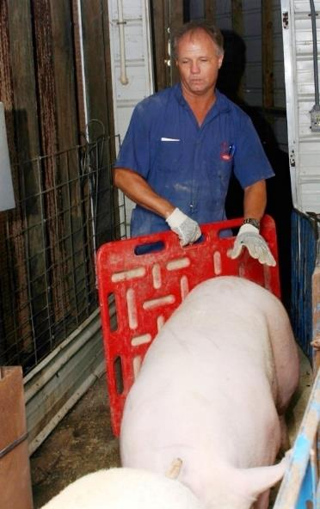
Breeding Stock
Handling
Handling Various Types & Sizes
In crowded spaces, they are likely to hold still in handler’s bubble. Give space & minimize noise, contact, and people.
Large, powerful pigs
  Sows, gilts, boars
  Use appropriate handling tools, not handler’s body
Are the most unpredictable
  Boars are especially dangerous because their tusks can cause injury so handlers should use extra caution and never turn their back to a boar
  Sows can be aggressive when they perceive litter is being threatened
Utilize techniques based on known pig behavior.
Ex: Leave front farrowing stall gate open to respect space.
Notes:
Breeding stock (sows, gilts and boars) are the largest and most powerful pigs a handler will work with and handlers should use extra caution when moving these animals. A sorting board should be used when moving a large animal. The handler should not use his or her body alone. If the animal appears aggressive or agitated, it may be safer for the handler to move out of the way than to risk potential injury.
Additionally, breeding stock are the most unpredictable animals, especially boars. Boars are particularly unpredictable when exhibiting mating behaviors, such as when they are being used for estrus detection. Boars are especially dangerous because their tusks can cause injury so handlers should use extra caution and never turn their back to a boar.
Sows can be aggressive as well, especially when they perceive their litter is being threatened (e.g. such as during piglet processing or weaning). In addition to their reproductive behaviors, pigs of breeding age require extra caution just because of their sheer body mass. Therefore, it is important for these pigs to be familiar with positive human interactions.
(Animate)
The ability to move breeding females and boars in and out of pens and/or individual housing units can vary greatly between handlers. In crowded spaces, these larger animals are likely to hold still rather than surge out of a handler’s bubble unless they are totally panicked. Handlers who have problems moving breeding stock tend to work too close and use continuous, urgent contact. To aid movement of breeding stock, handlers should give them space, move as groups when feasible, and minimize contact, noise, people and other activity.
(Animate)
There are many techniques that can be used based on what is known about pig behavior. For example, when trying to move a sow into a farrowing stall she may resist because she sees her path is blocked by the stall end being closed. This may be overcome by leaving the stall door open and having someone close it when she enters the stall, but before she can move out the far end. The handler at the front of the stall should stand still and step away if the sow stops and looks at them as they are blocking her path. The handler behind the sow must respect her space and let her move.
These large animals also can cause injury, to people or pigs, through sudden movement of their heads or by pinning the handler between the pig and a fixed object such as a gate or feeder. Often this type of injury is a result of the handler’s arm or leg being in the wrong place at the wrong time. An example may be a crushing or pinching injury to a hand or foot when a pig closes a gate with its body.

Slide 35
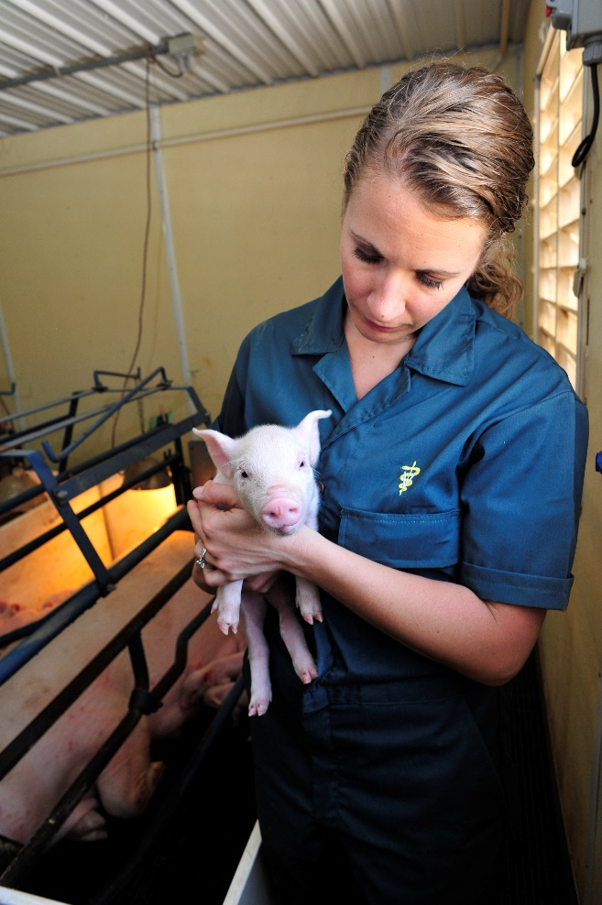
Piglets
Handling
Handling Various Types & Sizes
Pick up piglets:
  Under rib cage
  By a rear leg above the hock
Only release when piglet has two points of contact
May be safety challenge
  Sharp teeth
  Active (squirm, wiggle)
Sows may attempt to bite the handler when reaching for the piglet
Moved by herding or picking up and moving them by hand or cart
Piglets should not be tossed or thrown.
Notes:
Handling piglets can present a safety challenge to the handler. Piglets have sharp teeth and can bite the handler when they are picked up. The sow may also attempt to bite the handler when he or she reaches into the stall to grab a piglet.
Piglets can either be moved by herding or by picking them up and moving them by hand or with a cart.
(Animate)
Piglets should be picked up by holding under the rib cage or by grabbing a rear leg, above the hock, and then gently setting the piglets into a cart, alleyway or pen. Before releasing a pig to the ground the pig should have two points of contact before the handler lets go (i.e. both front legs) Piglets may squirm and wiggle when picked up so care should be used so that they are not dropped.
(Animate)
Piglets should not be tossed or thrown. When being held for an extended period of time, piglets should be held under the rib cage next to the handler’s body or by both rear legs using two hands.

Slide 36
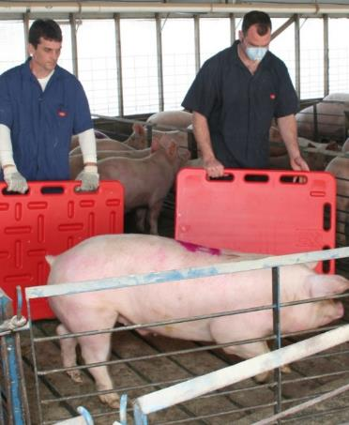
Nursery and Finisher Pigs
Handling
Handling Various Types & Sizes
Rely on a sorting board instead of your body to turn or stop large finishing pigs.
Move in the pen with your knees slightly bent to avoid sprains from pig contact.
If an animal gets excited, it may be safest to move out of the way to avoid potential injury and to let the pig calm down
Utilize pigs’ natural behaviors
  Moving out of full pens with narrow gates: don’t get behind and chase, use your bubble and encourage to circle toward the gate
  Sorting out of pens: work in pairs with one working the pen and the other sorting; ensure only one handler is moving or applying pressure at a time
Notes:
Nursery and finisher pigs grow rapidly and quickly become too large to lift and/or hold. When moving nursery and finisher pigs, our primary tool needs to be the effective use of pigs’ natural behavior and movement patterns as outlined in Chapter 1, Pig Behavior.
We often move nursery and finisher pigs out of full pens where restricted space encourages them to circle around the handler or stop and bunch, and through narrower gates that don’t allow all animals to exit at once. Getting behind and chasing pigs towards the gate encourages them to stop, crowd and bunch at the gate or circle away from the gate. By working from a different position we can encourage pigs to circle towards the gate and prevent pigs from stopping and bunching.
When sorting and moving these pigs, it is often the best practice to work in pairs and have one person work the pen gate while the other sorts the pigs with a sorting board. This is especially true when finished pigs are being sorted for load-out as the first pigs may be reluctant to leave their pen mates. When emptying entire pens, work along the side of the pen on the inside of the arc you want pigs to follow, and use your bubble to narrow the flow so pigs keep moving when they arrive at the gate. The most effective position will be closer to the gate than many people feel comfortable with. If there is more than one handler, both work along the side of the pen instead of behind the pigs and only one person applies pressure at any time. Always pay attention to where your position and bubble are taking pigs and adjust as needed.
(Animate)
Handlers should rely on a sorting board instead of their bodies to turn or stop large finishing pigs. A bi-fold panel is a particularly useful device as it creates a corralling effect, reduces an escape route for the pig and increases safety for the handler.
If you stand in a pen with your legs locked you are at greater risk for leg sprains and strains if a pig runs into your knee. Instead, standing with knees slightly bent with a sorting board offers a buffer for your knees if a pig makes contact with your sort board and legs.
When an animal does get excited it may be safest for the handler to move out of the way to avoid potential injury and to let the pig calm down. Sometimes 20 to 30 minutes is required to allow pigs to calm down and become easier to move.

Slide 37
Group Sizes
Handling
Handling Various Types & Sizes
Industry best practice to balance safety and efficiency
Adjust group size based on your facility and conditions to yield calm, consistent movement
Pig type/size | Suggested group size
Weaned piglets | 20
Nursery pigs | 20
Finished/Market pigs | 3-5
Sows/Gilts | 1-5¹
Boars | 1-5¹
¹Depending upon temperament and safety conditions, may require moving individually.
Notes:
Pigs should be moved in groups large enough to be efficient for the production system, but small enough to be safe for the pigs and the handler(s). Groups of finished pigs and breeding stock should be small enough so that the handler can maintain control of all of the pigs in the group so handling interventions can be applied to the pigs not moving. The handler should always remember that using too much pressure or by crowding the rear pigs can stop the movement of the front pigs. The suggested group sizes are based on best industry practice, but it’s important to remember that facility design and conditions of the environment and/ or animals may require adjustment.
Research has shown that when a farm moved 8 pigs in a group vs. 4 pigs in a group to the truck, it took longer to load the truck when they moved groups of 8 pigs. Additional research shows that moving 4 vs. 8 pigs reduces losses due to dead at arrival and nonambulatory pigs by half.

Slide 38
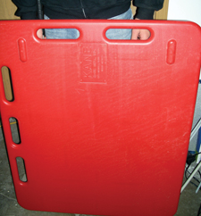
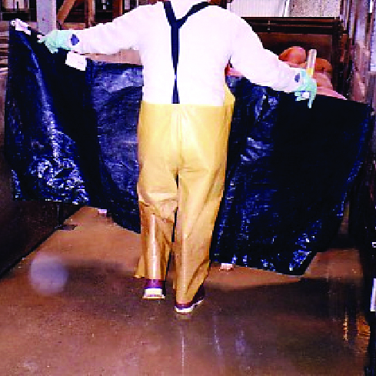
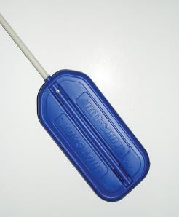
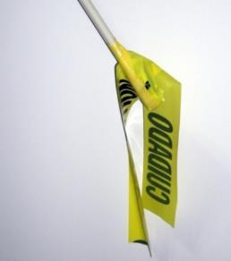
Tools and Equipment
Handling
Tools can be used as a/an
  Physical barrier – Sort board
  Visual barrier - Matador’s cape
  Auditory stimulus – Rattle/Shaker paddle
  Visual stimulus – Nylon flag
Notes:
There are many different pieces of handling and sorting equipment on the market, or that can be easily made on the farm, to help you sort or move pigs in a safe, humane and efficient manner.
Handling equipment is effective by providing barriers or stimuli including:
Physical barrier (i.e.,. Sorting board)
Visual barrier (i.e.,. Matador’s cape)
Auditory stimulus (i.e.,. Rattle/Shaker paddle)
Visual stimulus (i.e.,. Nylon flag)
The most versatile tool is typically the sorting board or sorting panel and can be a single or bifold panel. A sorting board can provide both a physical and a visual barrier.

Slide 39
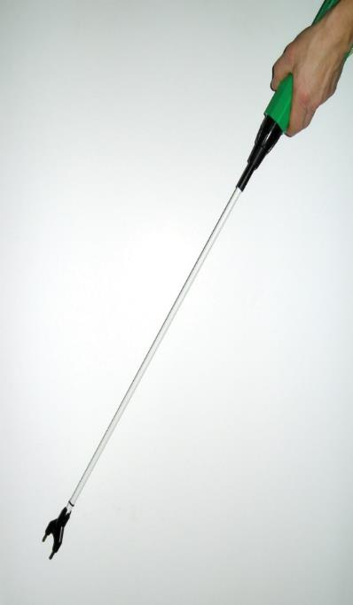
Tools and Equipment
Handling
Tap pig with the wand without using shock
Never use an electric prod in a pen when moving pigs towards an alleyway
Never shock a pig in a sensitive area including eyes, ears, ears, nose, genitals or rectum
Apply to the back of the pig behind the shoulder
Duration of the shock should not exceed 1 sec
Count to 5 before administering any additional taps or shocks
The pig should be allowed time to respond before another shock is given. If you have already delivered 2 shocks to an individual pig, STOP
Tool of last resort – used only when absolutely necessary under strict guidelines
Many packing plants do not tolerate their use at all
Figure out why pigs aren’t moving and prevent the problem from happening
Notes:
Another tool is an electric prod, which only should be used when absolutely necessary and only following strict guidelines.
Realize that any use of electric prods in most packing plants is not tolerated because it elevates stress levels in pigs more than any other method of moving pigs. Research shows that even minimal electric prod use changes blood lactic acid levels and impacts meat quality.
Most importantly, figure out how to prevent bunching or piling of pigs at that location in the future. Is it lighting? Is there a cool breeze there? Is it a situation that requires moving fewer pigs? What can be done to eliminate or minimize the use of electrical prodding at that point?
If it is deemed necessary to use this tool, ensure you are familiar with the strict guidelines:
(Animate)
If electrical prods are used:
Tap pig with the wand without using shock Never use an electric prod in a pen when moving pigs towards an alleyway. This is unnecessary for we have many other tools that more effectively maneuver pigs in the pen such as sort boards.
Never shock a pig in a sensitive area including eyes, ears, ears, nose, genitals or rectum
Apply to the back of the pig behind the shoulder. If you shock the pig in front of the point of balance, the pig will move backwards.
Duration of the shock should not exceed 1 sec
Count to 5 before administering any additional taps or shocks
The pig should be allowed time to respond before another shock is given. If you have already delivered 2 shocks to an individual pig, STOP.

Slide 40
SAFE ANIMAL HANDLING PRACTICES
Handling
Human injuries happen more often when people are handling animals than during any other activity performed in pork production;
Common injuries:
  Contact injuries, slipping and falling, head cuts, or bumps and bruises when on the trailer
Remain aware of the environment to avoid injury to self
Notes:
Human injuries happen more often when people are handling animals than during any other activity performed in pork production. Common handler injuries when moving pigs are contact injuries, slipping and falling, head cuts, or bumps and bruises when on the trailer. Handler scrapes, bruising, and falls are some common injuries when moving sows or boars in the farrowing, gestation, or gilt acclimation barns. Some of these can be prevented by being more aware of the environment. Power washer hook ups, cords from heat lamps, heaters, and gating can all contribute to worker hand and limb injury. Handlers must remain aware of their environment to avoid self-injury.
Accidents are more likely to happen to new employees with 11 months or less of experience. The risk for injury increases again in workers aged 45 to 64. New handlers need training to understand how to best protect themselves. Even handlers who have years of experience must continue to wear safety gear and work at an appropriate pace to prevent injury.

Slide 41
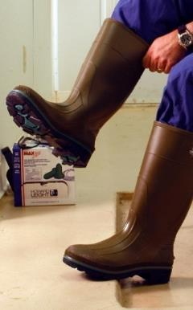
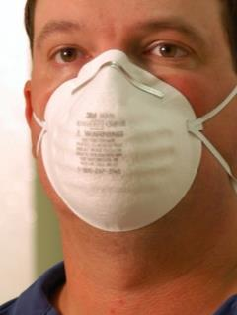
Personal Protective Equipment (PPE)
Handling
Conduct hazard assessment
  Review tasks
  List potential injuries
  List PPE
Typical minimum PPE
  Safety-toed boots
  Sorting board
  In a truck/trailer
    Knee pads and/or shin guards
    Bump helmet
Additional PPE
  Dust mask
  Eye and hearing protection
  Gloves
Notes:
To determine what Personal Protective Equipment (PPE) is required, the handler should conduct a hazard assessment. Walk through the tasks required during loading, transport and unloading. Then, considering the equipment to be used, make a list of potential injuries that could occur. Develop a list of PPE that should be worn by the handler to help protect them from those injuries. Protective equipment may vary based on the size of the animals.
Typically, the minimum amount of PPE a handler should consider when handling pigs is a pair of safety-toed boots and a sorting board. Handlers operating inside a truck/trailer should also consider wearing knee pads and/or shin guards and a bump helmet or hard hat to protect themselves from possible injury due to contact with the trailer’s surfaces. For handlers entering the trailer, head injury is the most common injury reported. Wear your hard hat to avoid head cuts, bumps, and bruises.
All handlers should also consider using these PPE items, depending upon the hazard assessment and company protocols:
Dust mask
Eye protection
Hearing protection
Gloves
Sort boards
Shin guards
Knee pads
Hard hats

Slide 42
Summary
Handling
How you choose to communicate with the pigs you move effects their behavior and meat quality:
  Walk pens on a daily basis
  When moving pigs, act calmly and avoid sudden movement, loud noises, and other actions that may frighten or excite pigs
  Move pigs at their normal walking pace
As handlers:
  Understand basic handling protocols for certain sizes and types of pigs
  Move the correct group size for the type of pigs being handled
  Understand handling equipment and when to use these tools so they are effective
  Minimize or eliminate electric prod use when loading pigs
  Understand personal protective equipment for loading, transport and unloading
Notes:
To summarize, how you choose to communicate with the pigs you move effects their behavior and meat quality:
Walk pens on a daily basis
When moving pigs, act calmly and avoid sudden movement, loud noises, and other actions that may frighten or excite pigs
Move pigs at their normal walking pace
As handlers:
Understand basic handling protocols for certain sizes and types of pigs
Move the correct group size for the type of pigs being handled
Understand handling equipment and when to use these tools so they are effective
Minimize or eliminate electric prod use when loading pigs
Understand personal protective equipment for loading, transport, and unloading

Slide 43
5. Fitness of the Pig
Notes:
All pigs that are scheduled for transport should be evaluated by a handler for fitness to travel.

Slide 44
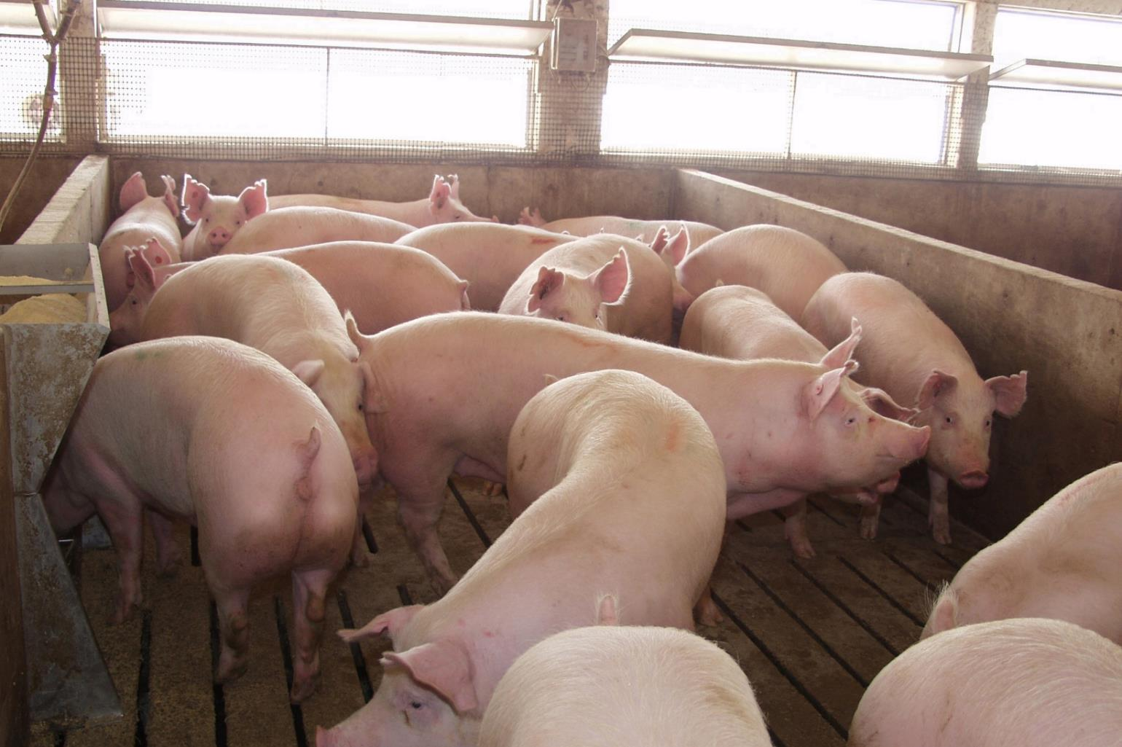
5. Fitness of Pig
Section Objectives
Evaluate the fitness of a pig and its readiness for transportation in each phase of production.
  Identify which animals are, and which are not, appropriate to transport and why.
  Describe how to resolve potential conflicts regarding fitness of the pig during the loading/unloading process.
Compare the roles and relationships of proper animal handling, weight and phenotype.
Notes:
(Briefly review the objectives for this section.)

Slide 45
Fitness of the Pig
5. Fitness of Pig
It is the position of the National Pork Board that any pig unable to walk, is ill or significantly injured, should not be transported to market channels.
  Where likelihood of recovery is low, even with treatment, pig should be humanely euthanized
  Any pig that becomes fatigued should be moved to a resting area in an appropriate manner
  A fatigued pig is defined as having temporarily lost the ability to walk but has a reasonable expectation to recover full locomotion with rest
  Resting area helps enable recovery by minimizing competition for feed and water and provides the opportunity for monitoring
Notes:
It is the position of the National Pork Board that any pig that is unable to walk, is ill, or is significantly injured should not be transported to market channels.
Where the likelihood of recovery is low, even with treatment, the pig should be humanely euthanized.
Any pig that becomes fatigued should be moved to a resting area in an appropriate manner.
A fatigued pig is defined as having temporarily lost the ability to walk but has a reasonable expectation to recover full locomotion with rest.
A resting area helps enable recovery by minimizing competition for feed and water and provides the opportunity for monitoring.

Slide 46
Fitness of the Pig
5. Fitness of Pig
Evaluate pigs before loading
Examples of pigs unfit for transport
  Sick, injured, weak, disabled, or fatigued
  Unable to stand unaided and bear weight on each leg
  Blind in both eyes
  Cannot be moved without causing them additional suffering
  Body condition would result in poor welfare because of the expected climatic conditions
  Newborn with an unhealed navel
  Pregnant animals which would be in the final 10% of their gestational period at the planned time of unloading unless special conditions provided
  Females traveling without young which have given birth within the previous 48 hours
Notes:
All pigs scheduled for transport should be evaluated by a handler for fitness to travel. If a pig is found to be unfit, it should not be loaded. Instead it should be segregated for treatment or humane euthanasia.
The following list provides some examples of animals that are unfit to be transported, including, but not limited to:
Those that are sick, injured, weak, disabled or fatigued
Those that are unable to stand unaided and bear weight on each leg
Those that are blind in both eyes
Those that cannot be moved without causing them additional suffering
Those whose body condition would result in poor welfare because of the expected climatic conditions
Newborns with an unhealed navel
Pregnant animals which would be in the final 10 percent of the gestational period at the planned time of unloading (They may be transported if special conditions are provided and additional attention is given during transport)
Females traveling without young who have given birth within the past 48 hours

Slide 47
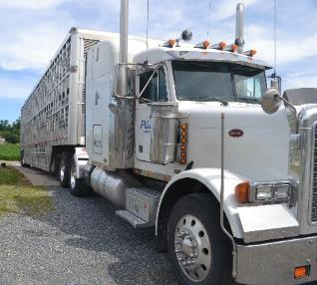
Fitness Concerns
5. Fitness of Pig
Common causes of transport losses:
  Heat stress
  Increased heart rate/failure
  Porcine Stress Syndrome (PSS)
  Fatigue
Notes:
Loading and unloading processes can be stressful events in the life of a pig. As described in Chapter 2, inappropriate handling techniques (aggressive handling), causing excessive stress and muscle exertion during loading and/or unloading, can exacerbate the stressfulness of this situation and potentially cause serious health problems and even death. Several of the more common causes of transport losses are heat stress, increased heart rate and heart failure, porcine stress syndrome (PSS) and fatigued pigs.

Slide 48
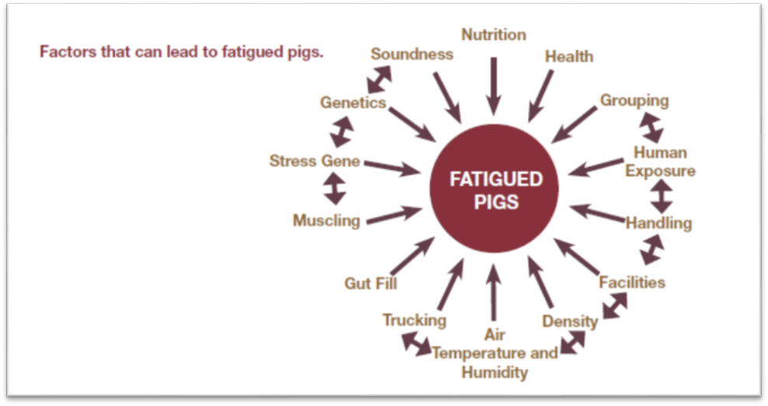
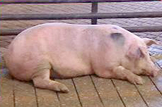
Fatigued Pigs
5. Fitness of Pig
Definition
  Temporarily lose the ability or the desire to walk
  Are reasonably expected to recover with rest
Have acid-base imbalance known as metabolic acidosis
  Can cause pork quality defects
Notes:
Fatigued pigs are defined as pigs that have temporarily lost the ability or desire to walk, but have a reasonable expectation to recover full locomotion with rest. Fatigued pigs typically have an acid-base imbalance due to excessive muscle exertion, which makes the blood more acidic in nature. This condition is commonly referred to as metabolic acidosis, which can cause pork quality defects and results in low-quality meat that is of significantly less value to the industry.
(Animate)
This diagram illustrates many of the contributing factors that can lead to injured, stressed or fatigued pigs. Take note of the factors that can be controlled by the producer, handler, or transporter.

Slide 49
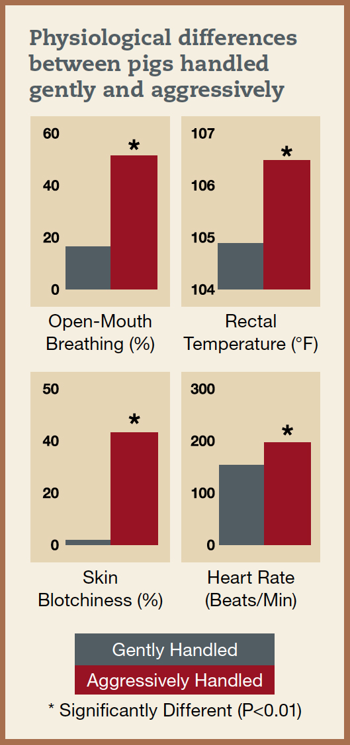
Stress Signs
5. Fitness of Pig
Identify and treat pigs showing signs of stress
  Open-mouth breathing (panting)
  Vocalization (squealing)
  Blotchy skin
  Stiffness
  Muscle tremors
  Reluctance to move
  Increased heart rate
  Elevated temperature
Notes:
When a pig experiences stress during handling or transport, it will display symptoms, such as open-mouth breathing, skin discoloration, or both. If the stress is not removed or if additional stressors are introduced, the pig will become reluctant to move, make abnormal vocalizations, develop muscle tremors, or some combination of these signs. At this stage, the pig may become overwhelmed by the accumulation of stress, in which case the pig will collapse and become non-ambulatory. In extreme cases, death may ensue.
Therefore, transporters and handlers must be able to identify the following signs of stress and take the appropriate action(s) when needed.
Open-mouth breathing (panting)
Vocalization (squealing)
Blotchy skin
Stiffness
Muscle tremors
Reluctance to move
Additionally, a pig’s heart rate and rectal temperature increase when excessively stressed or muscles are overexerted.
(Animate)
The graphs depict physiological differences between pigs handled gently (at a slow, calm pace with a plastic cane) and aggressively (at a rapid pace with an electric prod). The differences are quite clear.

Slide 50
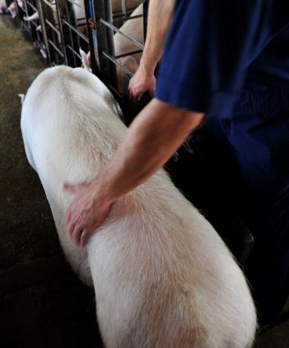
Prevention & Preparation
5. Fitness of Pig
Managing Ill, Injured, or Fatigued Pigs
Key Considerations:
  Handle ill, injured or fatigued pigs humanely
  Development of handling and movement protocol
  Producers should seek prevention through good production and handling practices
  Designate a resting area
  Pigs with a history of problems should be handled with extra care
Notes:
Prevention, preparation and prompt action are keys to the proper handling of pigs. What causes a pig to become a fatigued pig is not well understood although it is known that good production practices, along with proper handling, reduce the incidence of fatigued pigs.
There are several ways to implement good production practices, including:
Handling pigs that are ill, injured, or fatigued in a humane manner
Including proper handling and movement of ill, injured, or fatigued animals in the general handling and movement policy of production, transportation, and harvest operations
Seeking to prevent illness and injuries on the producer end by feeding nutritionally sound diets, maintaining effective health programs, providing good facilities, handling pigs properly, and selecting genetically and structurally sound breeding stock
Providing a resting area to help ill, injured, or fatigued pigs recover by minimizing competition for feed and water
Handling with extra care the pigs that appear healthy but have a history of health or respiratory problems, which may make them more susceptible to handling and transport stress

Slide 51
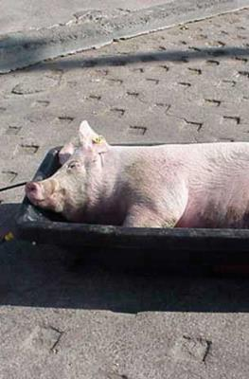


Moving Ill, Injured, or Fatigued Pigs
5. Fitness of Pig
Managing Ill, Injured, or Fatigued Pigs
Key points to consider
It is strictly prohibited to move pigs overtop of non-ambulatory pigs
It is also strictly prohibited for handlers to drag live animals or force them to move
Should include equipment appropriate for the size, age and condition of the animal
Efforts should be taken to not exacerbate and/or cause an injury to the animal
Recommended that at least two people are involved
Notes:
Based on federal regulation, it is strictly prohibited to move pigs overtop of non-ambulatory pigs. Non-ambulatory or dead pigs must be protected or moved out of the way first. It is also strictly prohibited for handlers to drag live animals or force them to move.
(Animate)
Handling methods for moving ill, injured or fatigued pigs should include equipment appropriate for the size, age and condition of the animal. When pigs become too large to be carried in a safe manner, proper tools for moving these animals should be used
Efforts should be taken to not exacerbate and/or cause an injury to the animal. From worker safety and animal handling perspectives it is recommended that a minimum of two individuals handle ill, injured or fatigued pigs

Slide 52
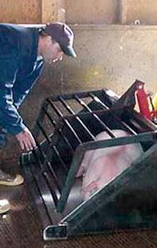
Tools for Moving
5. Fitness of Pig
Managing Ill, Injured, or Fatigued Pigs
Tools for moving an ill, injured, or fatigued pig
  Stretcher
  Sled
  Hand cart
  Mechanized equipment – loader
Basic Techniques
  Use two handlers
  Gently roll pigs, hold/push at flank and under forelegs
Notes:
There are a few tools at your disposal for moving ill, injured, or fatigued pigs. And remember, at the plant, it is appropriate to ask for help if you are using one of the below tools and safe use requires a second handler.
Stretchers – A stretcher requires two people to gently roll the animal onto it. Handlers should hold/push at the flank and under the forelegs. To prevent dislocation and bruising the animal’s legs should not be held.
Sleds – Tip the sled onto its side and roll the pig into the sled. A second handler may need to help hold the sled while the pig is rolled into it. The animal is more likely to allow itself to be pulled in the sled if it is laying on its side rather than its stomach. If a pig is rolled onto its stomach it may stand up and jump out of the sled.
Hand Carts – A cart can be modified with an enlarged platform and back board. The platform is slid under the pig or the pig is rolled onto the platform. The cart can then be tilted back to move the pig. A second handler should be present to assist in loading and steadying the pig on the platform.
Mechanized Equipment – If a skid-steer loader is used, the pig should be rolled into the bucket using the same techniques previously described. It is recommended that two handlers be used, one to operate the machine and one to roll the pig into the bucket. Loaders should be equipped with a special lid attachment on the bucket to prevent the pig from jumping or falling out. As in all other methods, the pigs must be off-loaded by gently rolling or lifting them out of the bucket. Loading pigs into the bucket using a wall, partition or fence is not acceptable.

Slide 53
Summary
5. Fitness of Pig
Evaluate for fitness prior to transport
There are three primary issues that can lead to increased transport losses:
  Fatigue,
  Heat Stress
  Porcine Stress Syndrome (PSS)
Animals that become ill or injured or fatigued during transport should always be handled humanely with the appropriate tools
Notes:
To summarize, all pigs should be evaluated by a handler for fitness to travel, and efforts should be made to prevent illness and injuries.
There are three primary issues that can lead to increased transport losses:
Fatigue
Heat Stress
Porcine Stress Syndrome (PSS)
If pigs are ill, injured, or fatigued, it is important to handle them humanely. For instance, animals that are unable to walk should not be transported to market channels, should never be forced to move, and should never be dragged by their ears, legs, or tails. Furthermore, some animals need to be segregated based on their special needs, resting areas should be provided, and before unloading, you need to notify the receiver of any such animals on the transport vehicle.

